Slide 1
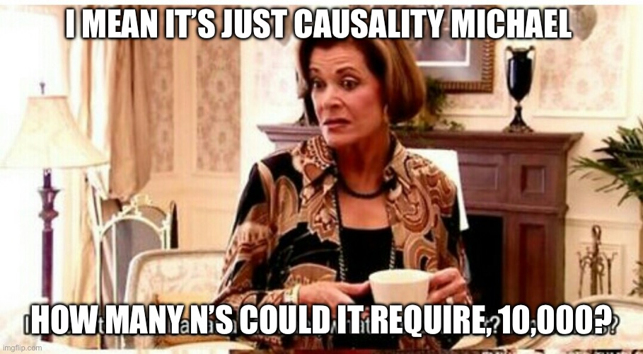
Quasi-Experiments for Policy Evaluation
Lee Kennedy-Shaffer
Course Week 11
Twitter, @marcfbellemare, https://twitter.com/marcfbellemare/status/1642646775801556994?s=20

Slide 2
Outline
Quasi-Experiments in General
Baseball’s Rule Changes
Possible Analyses
Difference-in-Differences
Complicating Assumptions
Synthetic Control

Slide 3
Quasi-Experiments

Slide 4
Quasi-Experiments
Nothing randomized, but a change (exogenous shock) occurred which was “as if random”
Cf. natural experiments: something was randomized but not by investigators

Slide 5
Design-based causal inference
We justify our causal assumptions through the study design, rather than adjusting for confounders after the fact
Different designs require different assumptions

Slide 6
MLB Throws a Curve: Baseball’s Rule Changes

Slide 7


Pandemic Baseball
Shortened Practice/Season
Expanded Playoffs
Additional Available Players
Universal Designated Hitter
Shortened Doubleheaders
And…
www.mlb.com
www.mlbplayers.com

Slide 8
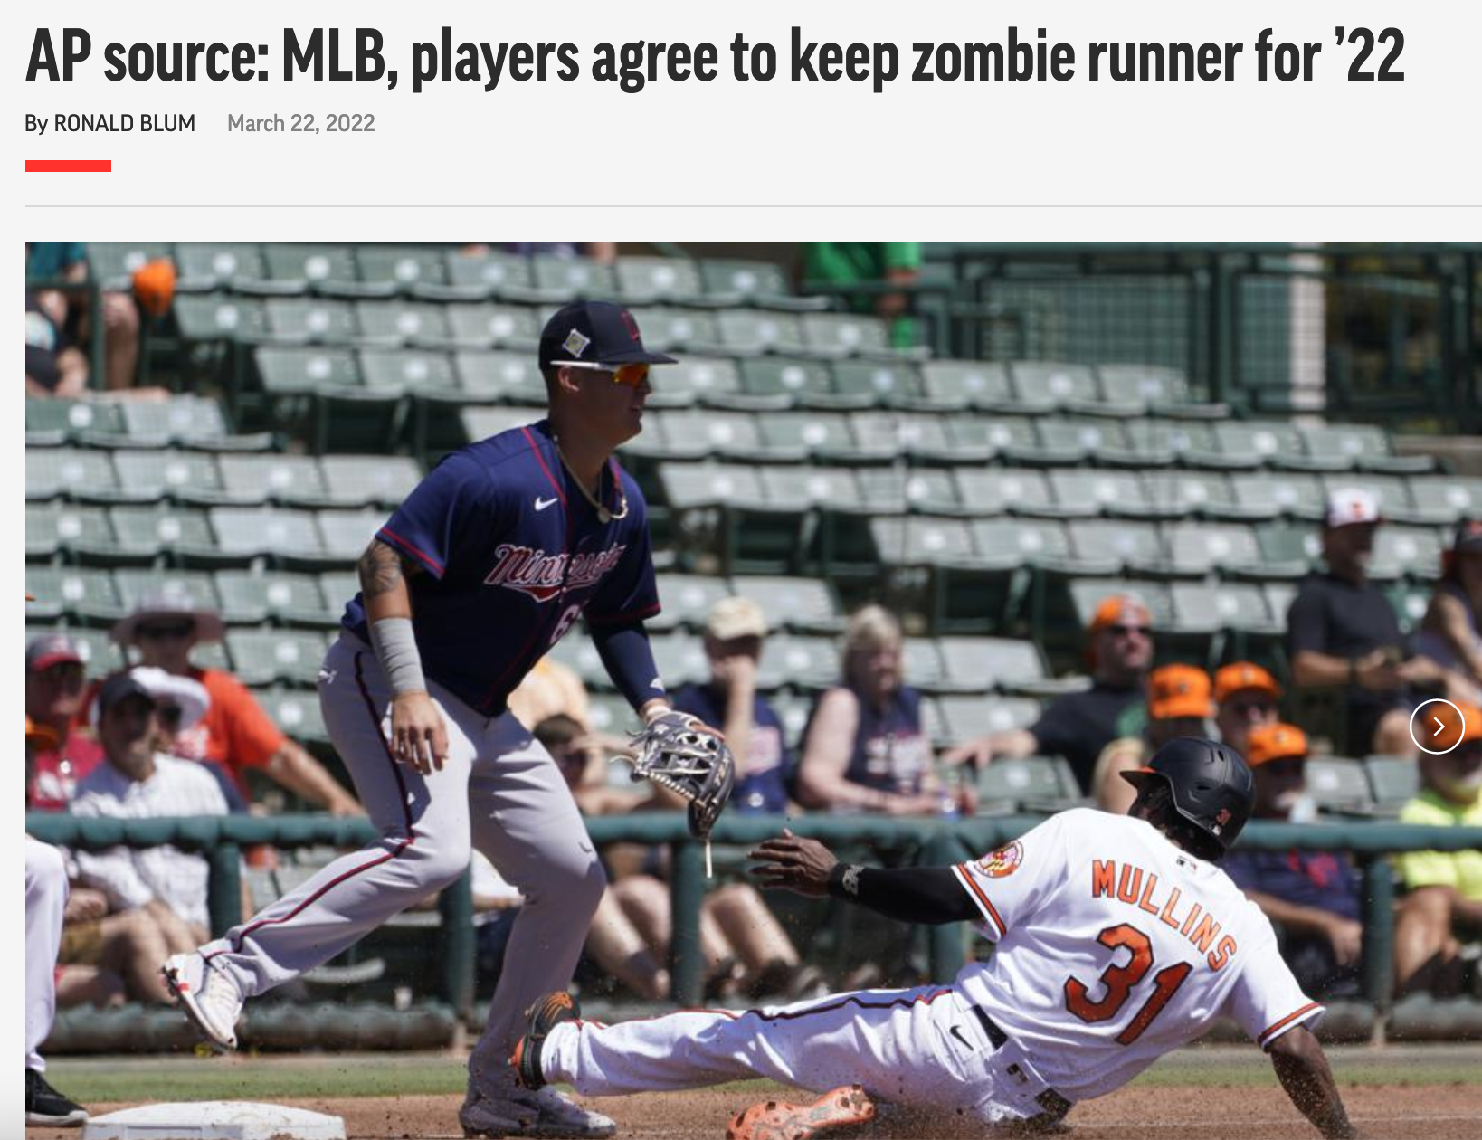
Zombie Runner
Automatic Runner at Second Base in
Extra Innings
https://apnews.com/article/covid-mlb-health-sports-shohei-ohtani-e1b96233ca0ac72ca72e9cfe36d0f5f7

Slide 9
What Effects Will This Change Have?
Outcome of Interest:
Innings?
Average Game Time?
Probability of Extra-Long Game?
Home Team Win Percentage?

Slide 10
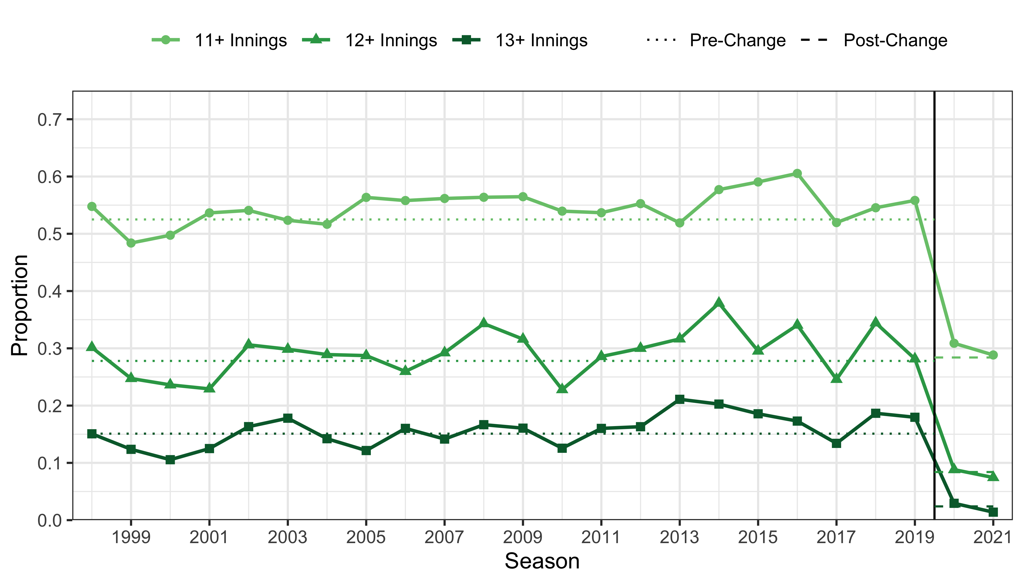
Number of Innings
Predictions: Jim Albert, https://baseballwithr.wordpress.com/2020/07/13/mlbs-new-extra-inning-rule/
Data: www.retrosheets.org/gamelogs

Slide 11
Possible Analyses

Slide 12
Our Goal
What is the effect of this change on the average time of extra-inning games?

Slide 13
Analysis Options
Change in innings times average time per inning
Assumes average time per inning does not change

Slide 14
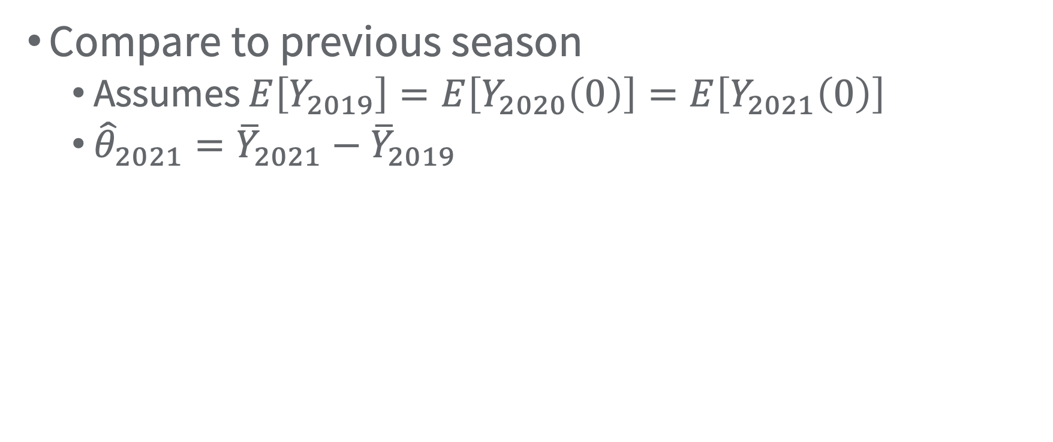
Analysis Options
Compare to previous season
Assumes $E\left[Y_{2019}\right]=E\left[Y_{2020}\left(0\right)\right]=E\left[Y_{2021}\left(0\right)\right]$
${\hat{θ}}_{2021}={\overline{Y}}_{2021}−{\overline{Y}}_{2019}$

Slide 15
Analysis Options
Compare to modelled trend from pre-change
Interrupted time series
Assumes that trend continues for counterfactual unaffected unit
Using a regression model with time as predictor

Slide 16
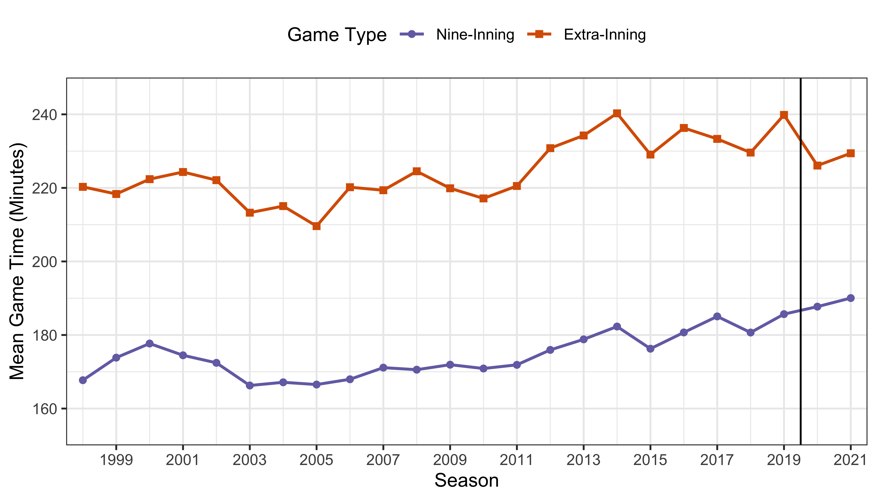
The Season (Time) Series
Observed treated unit
Data: www.retrosheets.org/gamelogs

Slide 17
The Season (Time) Series
Observed treated unit
Observed untreated unit
Data: www.retrosheets.org/gamelogs

Slide 18
Difference-in-Differences

Slide 19
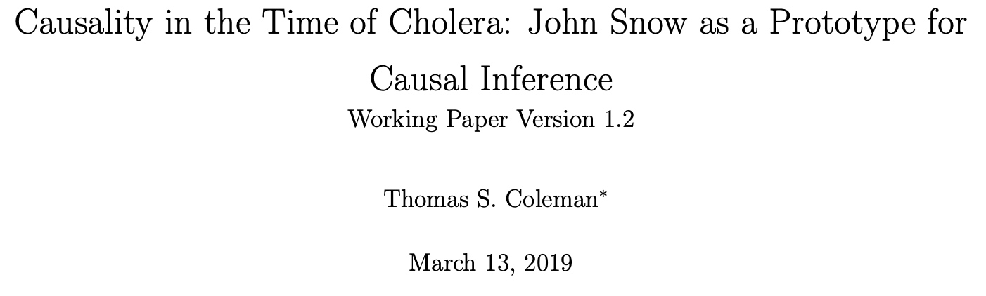
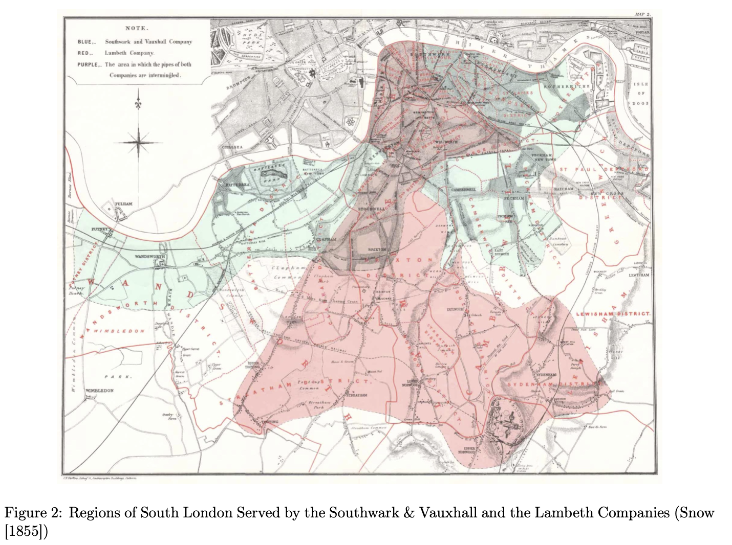
1854: Baseball in New York, Cholera in London (and also New York)

Slide 20
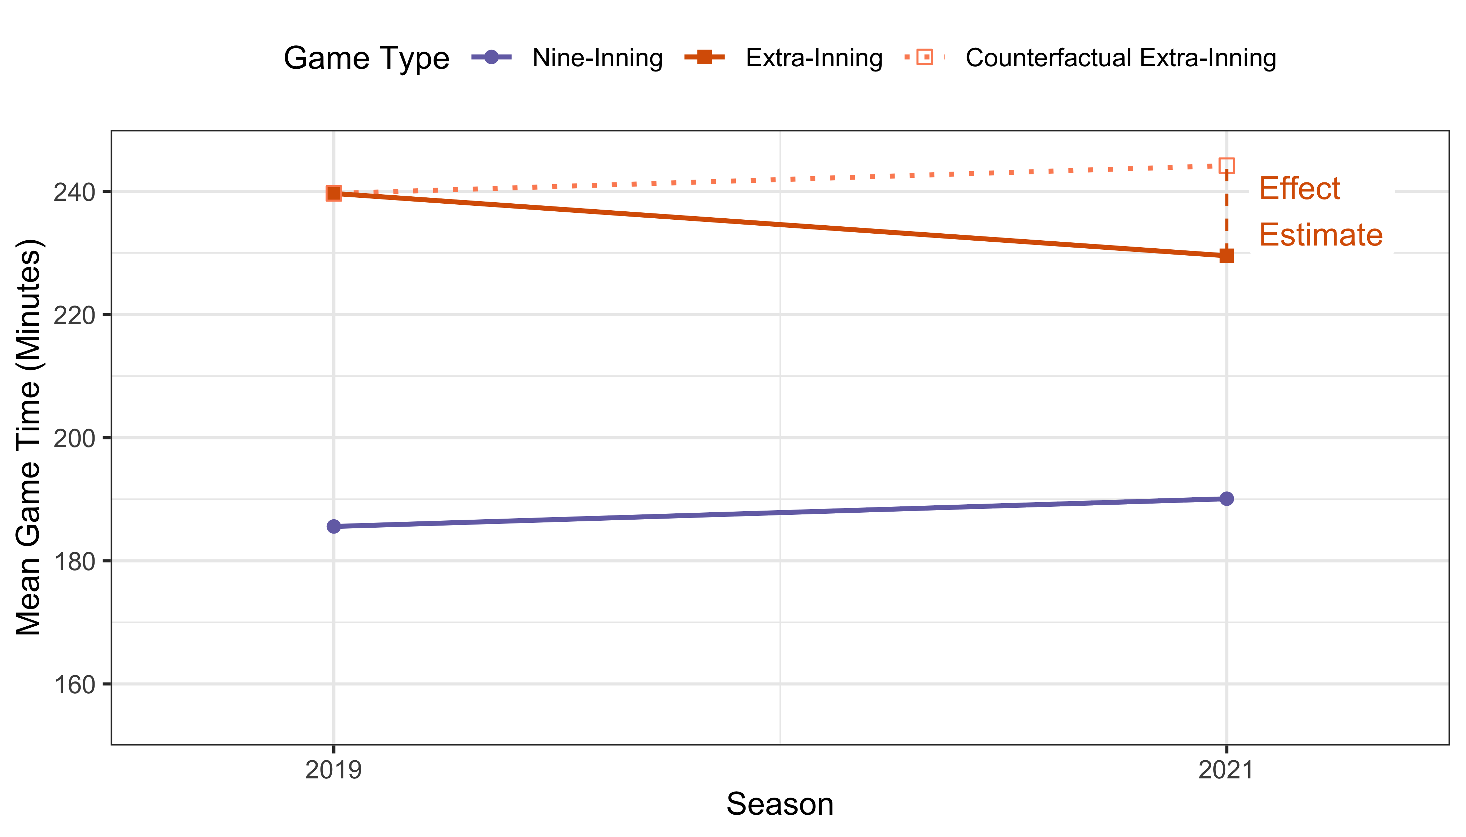
Difference-in-Differences
Effect
Estimate
Data: www.retrosheets.org/gamelogs

Slide 21
Estimate (Minutes)
Game Type | 2019 | 2021 | Difference, 2021–2019
Regular (9-Inning) | 185.6 | 190.1 | 4.5
Extra Innings | 239.7 | 229.5 | -10.1
Difference, Extra–Regular | 54.1 | 39.5 | -14.6
Data: www.retrosheets.org/gamelogs

Slide 22
Assumptions for Counterfactual
Exchangeability: in the trends of the potential outcomes
Consistency: policy affects only treated units and only in treated time periods (no anticipation, no spillover)

Slide 23
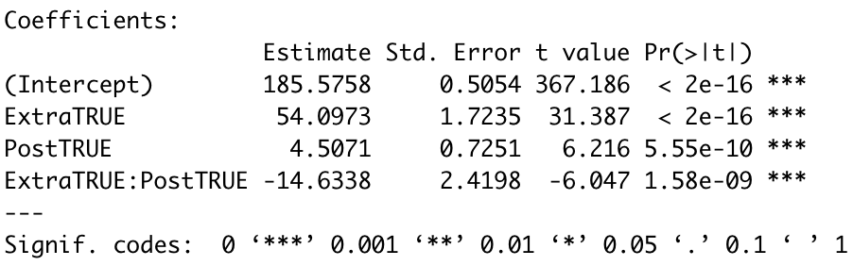
Statistical Formulation
$$Y_{ij}=β_{0}+β_{1}Extra_{i}+β_{2}Post_{j}+β_{3}Extra_{i}∗Post_{j}+ε_{ij}$$
95% CI (clustered by home team): (-20.9, -8.4)

Slide 24
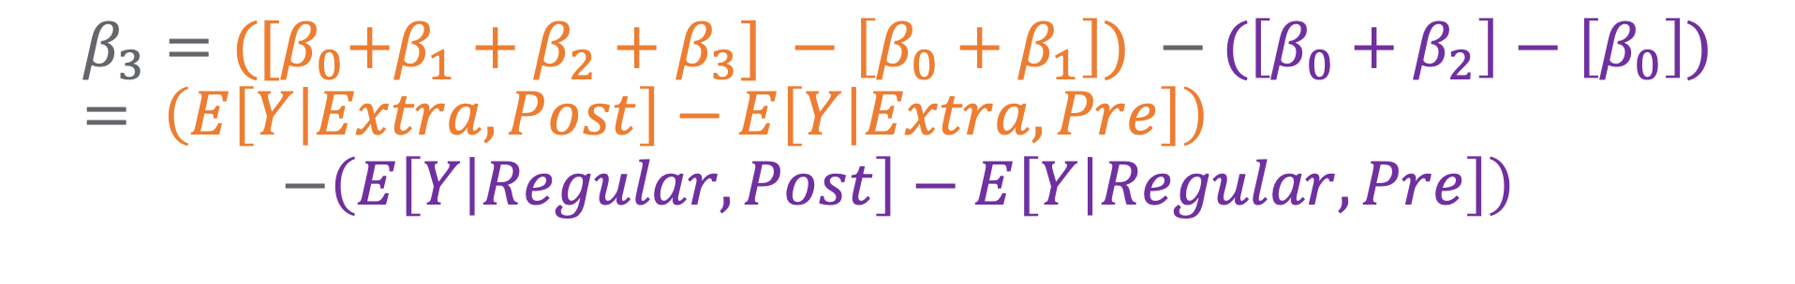
Counterfactual from Regression
$$Y_{ij}=β_{0}+β_{1}Extra_{i}+β_{2}Post_{j}+β_{3}Extra_{i}∗Post_{j}+ε_{ij}$$
$$β_{3}={([β}_{0}+β_{1}+β_{2}+β_{3}] −\left[β_{0}+β_{1}\right]) −(\left[β_{0}+β_{2}\right]−\left[β_{0}\right])= \left(E\left[Y | Extra,Post\right]−E\left[Y | Extra,Pre\right]\right)$$
$$−\left(E\left[Y | Regular,Post\right]−E\left[Y | Regular,Pre\right]\right)$$

Slide 25
Generalizability
DiD estimates the average treatment effect on the treated (ATT).

Slide 26
Parallel Trends Assumption
Data: www.retrosheets.org/gamelogs

Slide 27
Parallel Trends Assumption
Effect Estimate:
-14.6 minutes
Data: www.retrosheets.org/gamelogs

Slide 28
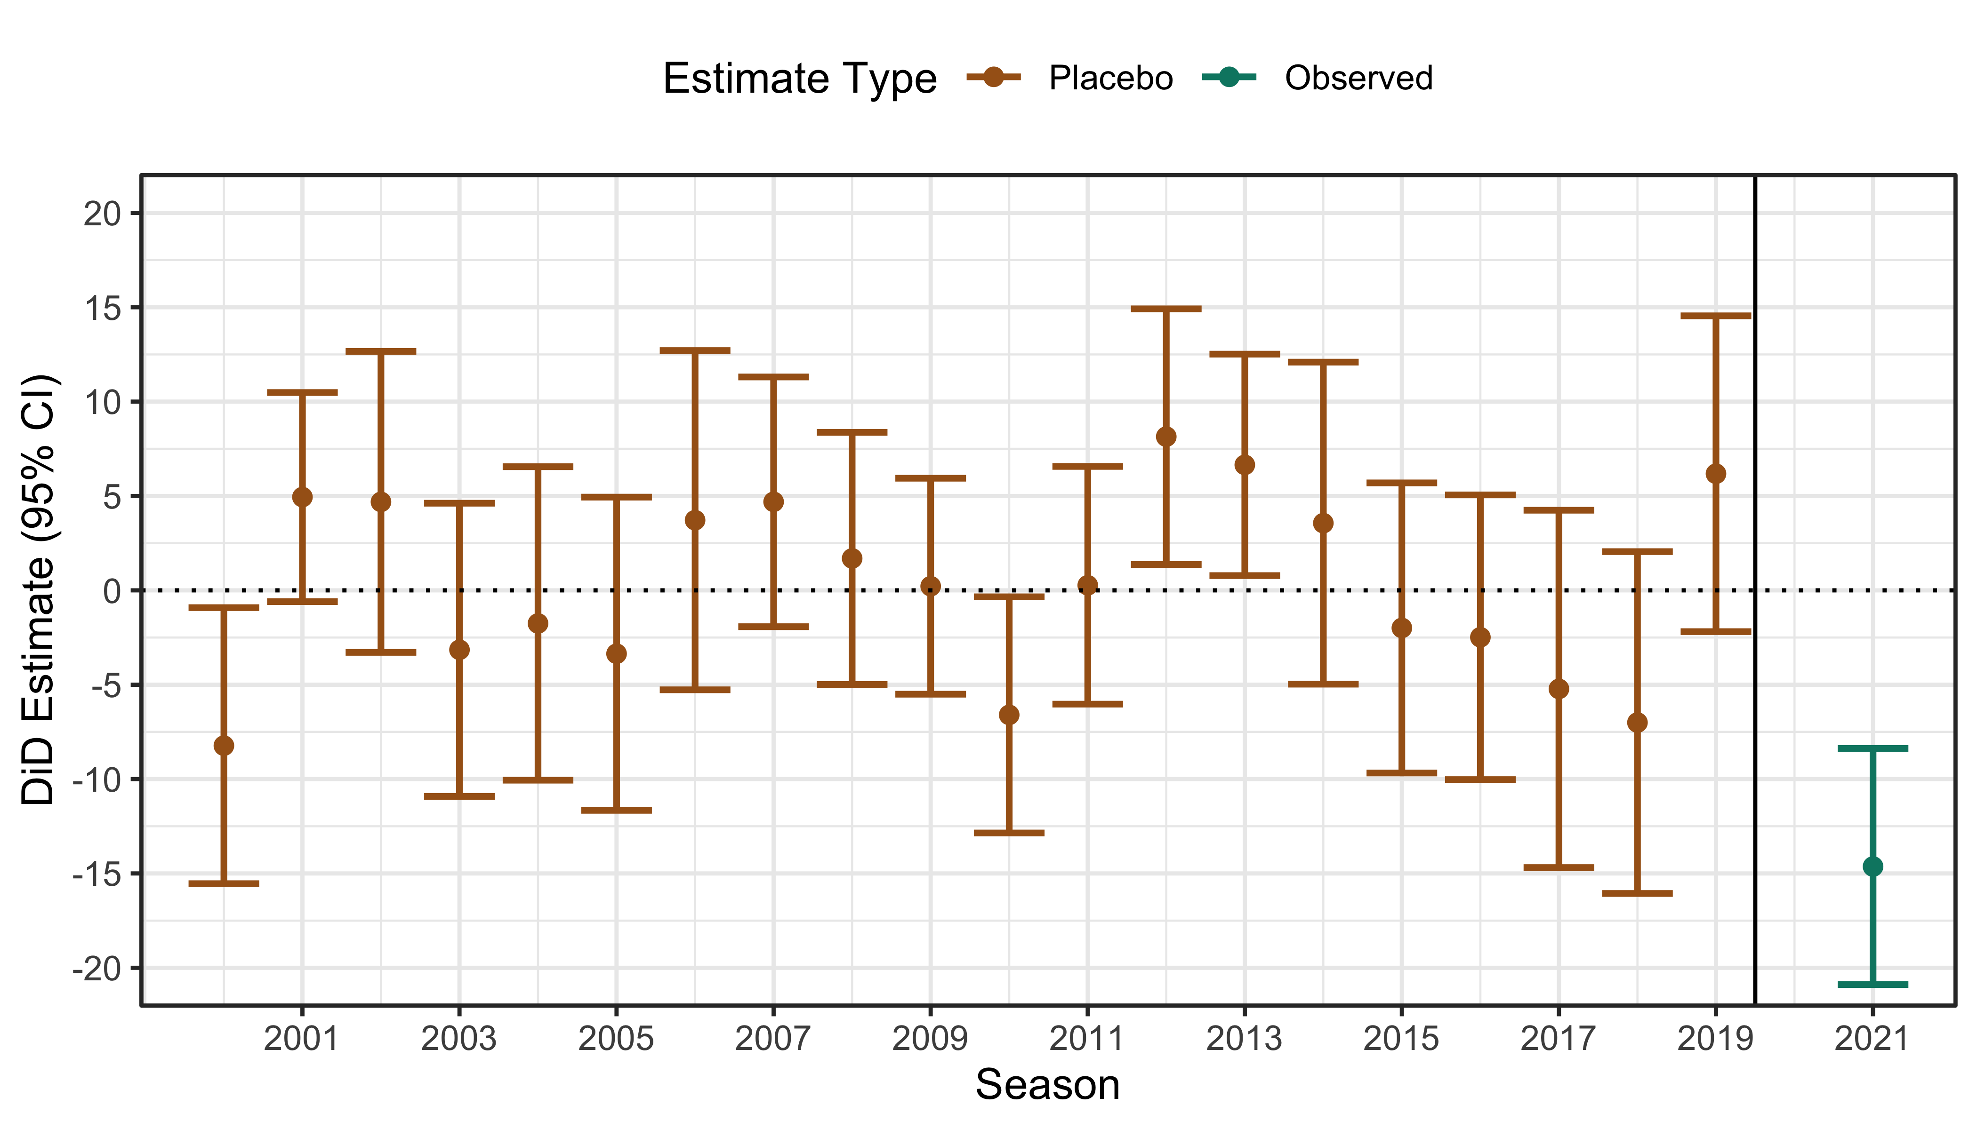
Causal Uncertainty: Placebo Tests
Data: www.retrosheets.org/gamelogs

Slide 29
It Ain’t Over Til It’s Over

Slide 30
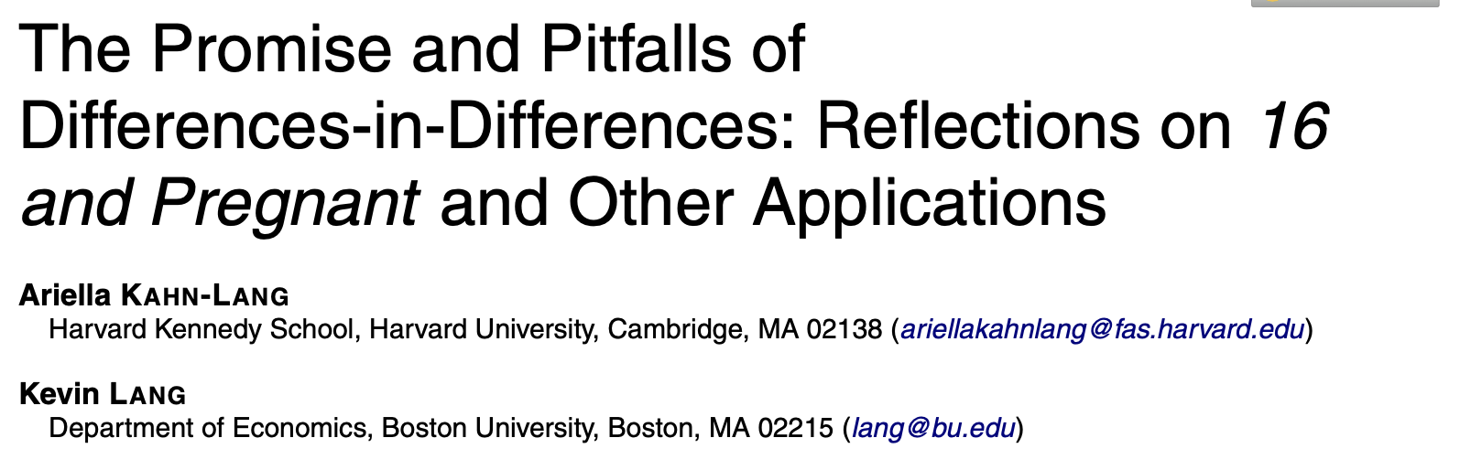
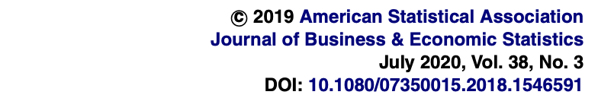
Changing the Scale

Slide 31
Changing the Scale
$${log⁡(Y}_{ij})=β_{0}+β_{1}Extra_{i}+β_{2}Post_{j}+β_{3}Extra_{i}∗Post_{j}+ε_{ij}$$

Slide 32
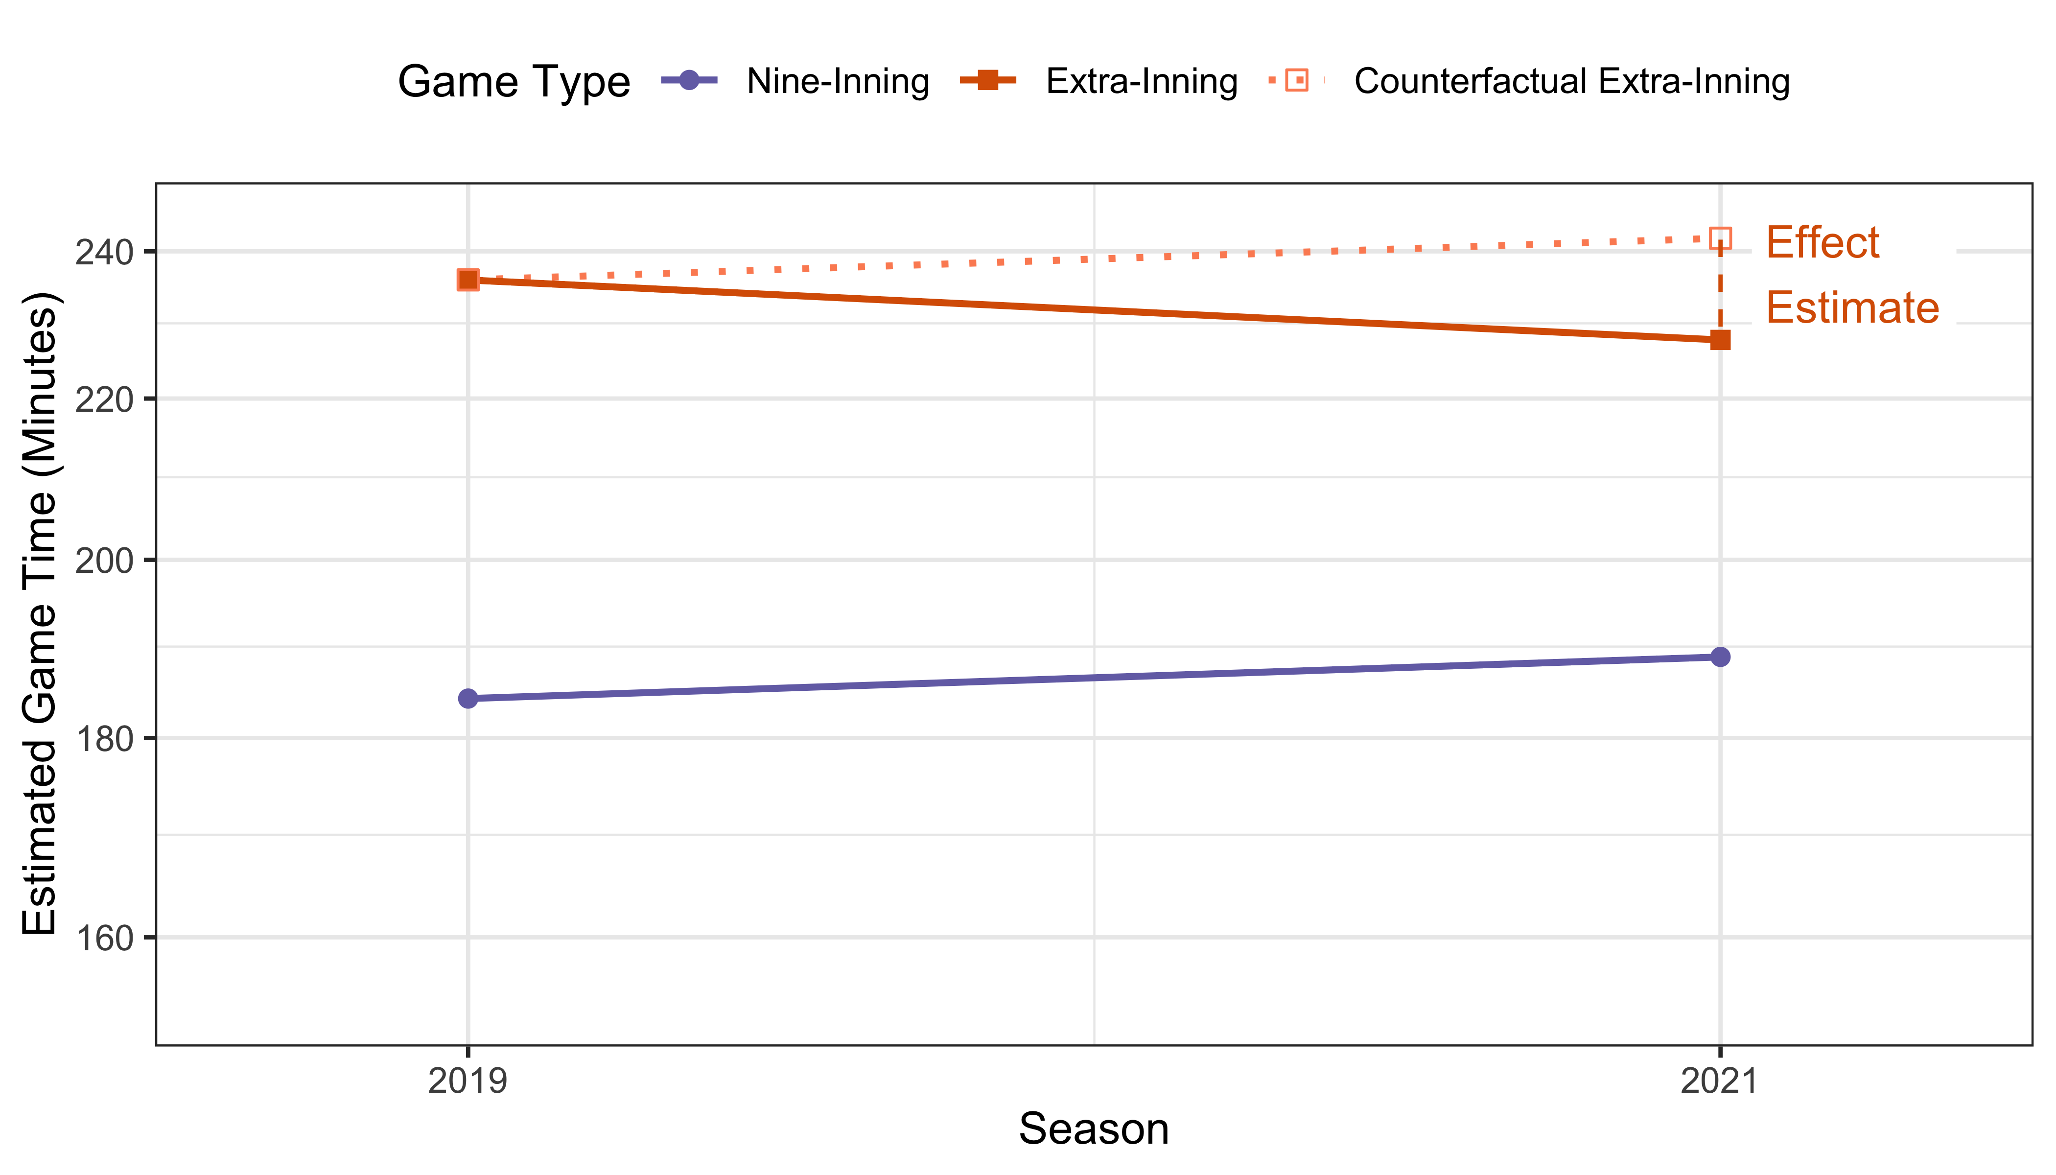
Changing the Scale Changes the Assumptions

Slide 33
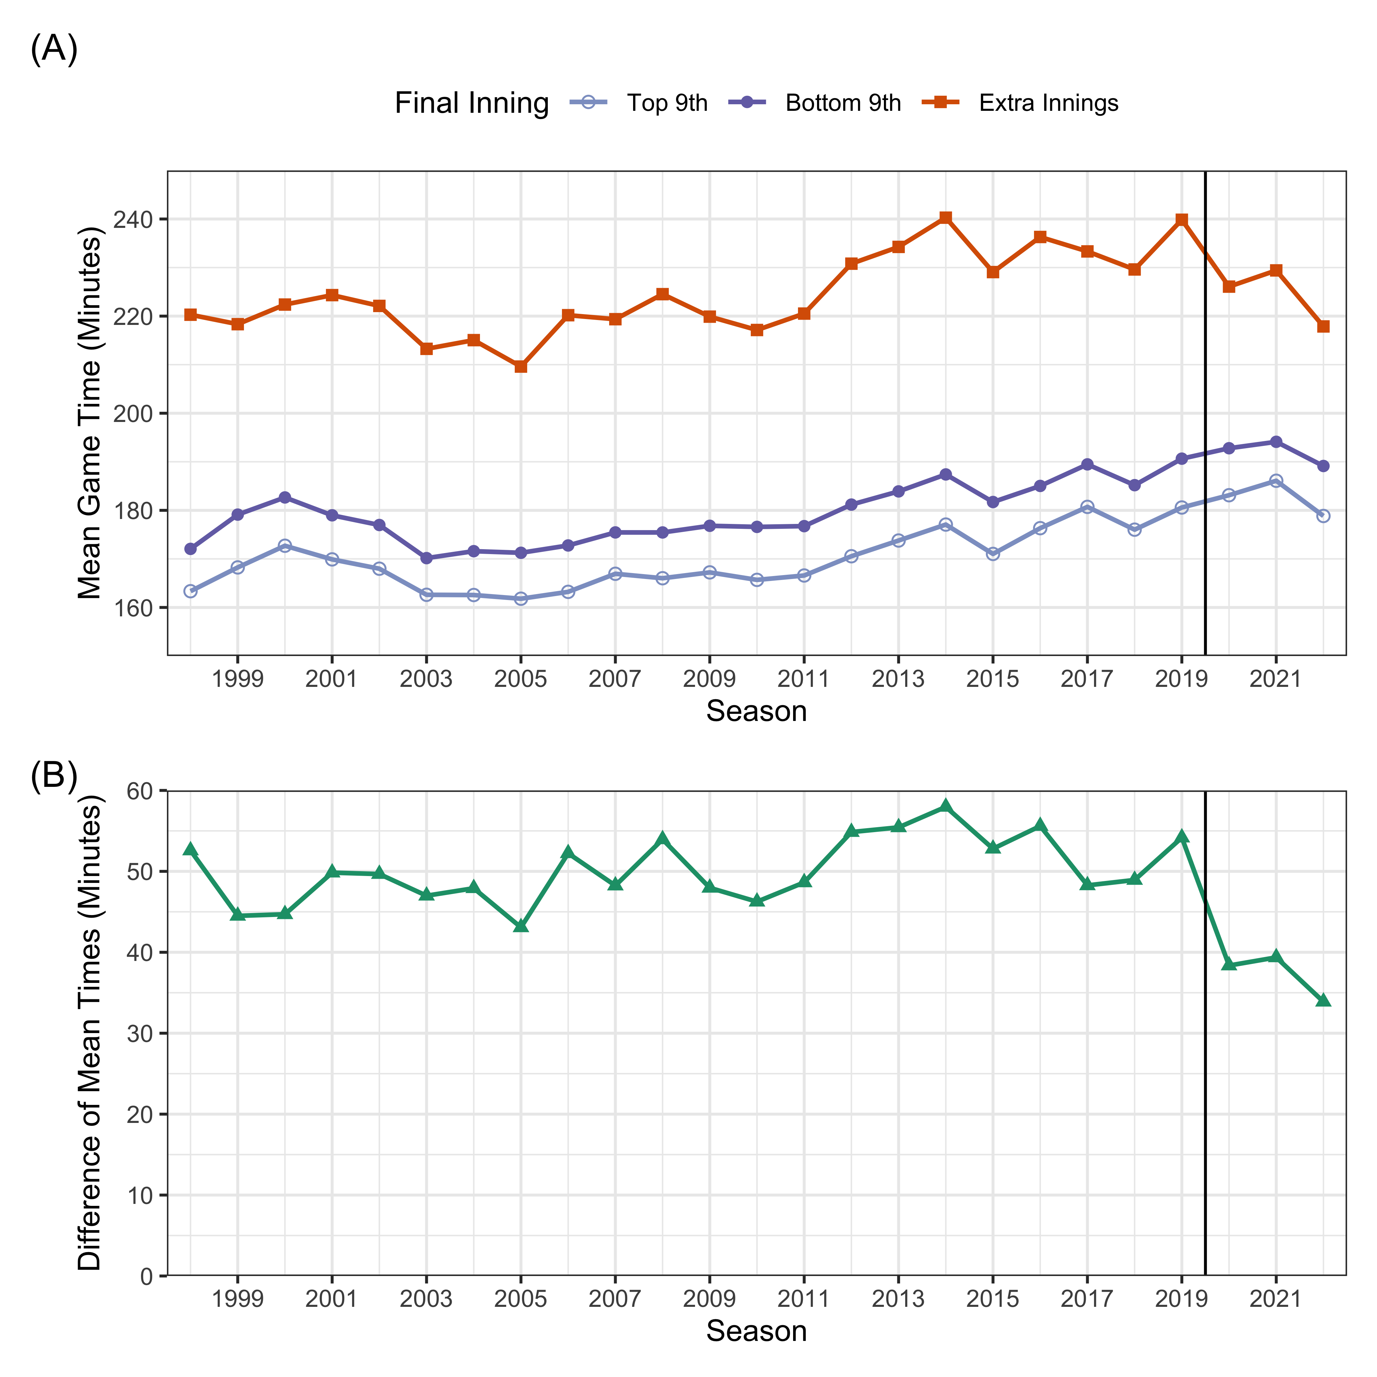
Parallel Trends: Linear?

Slide 34
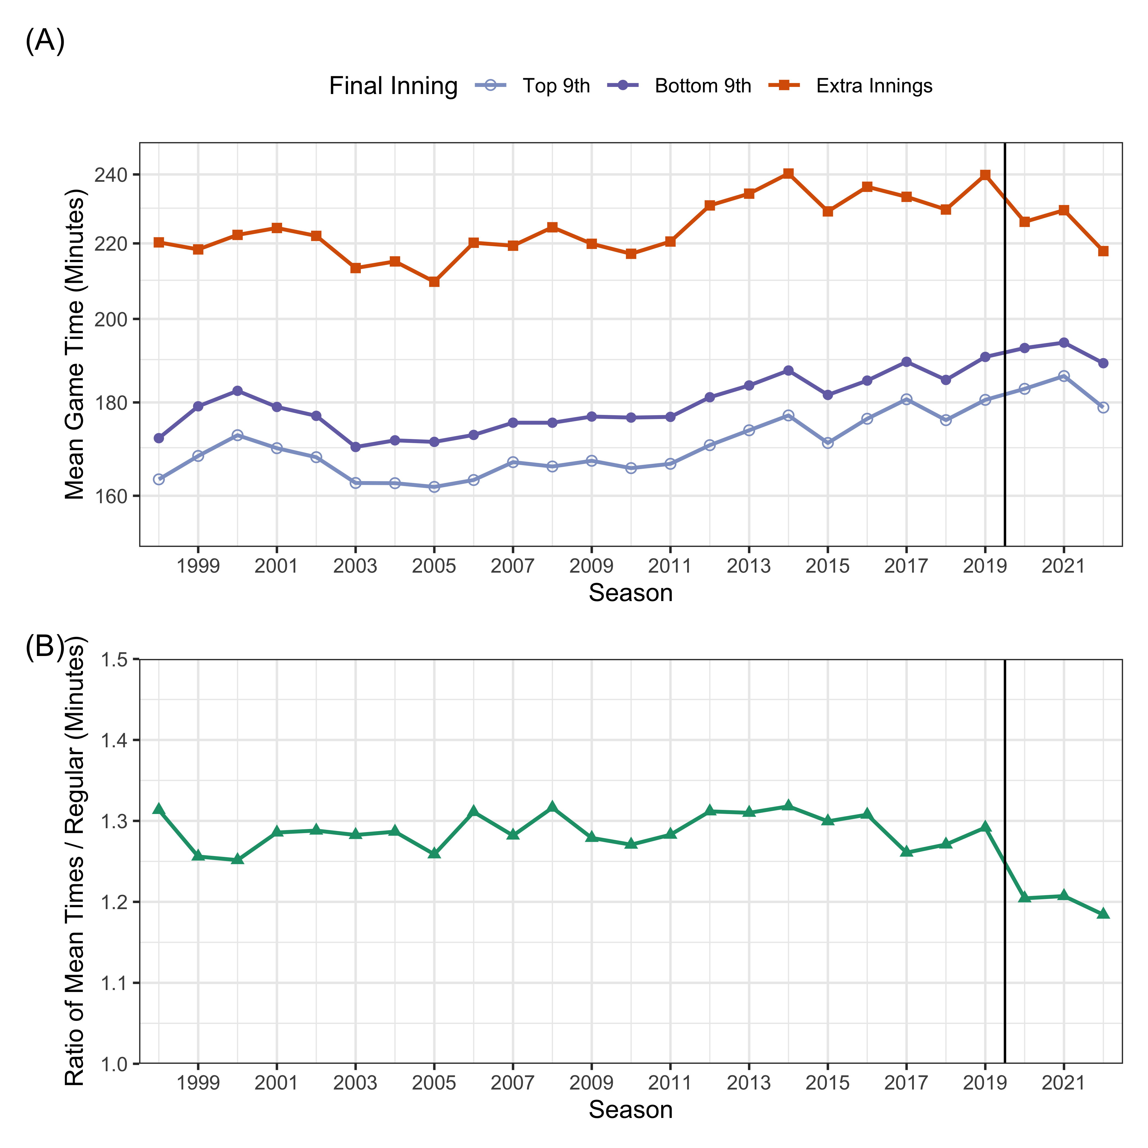
Parallel Trends: Log?

Slide 35
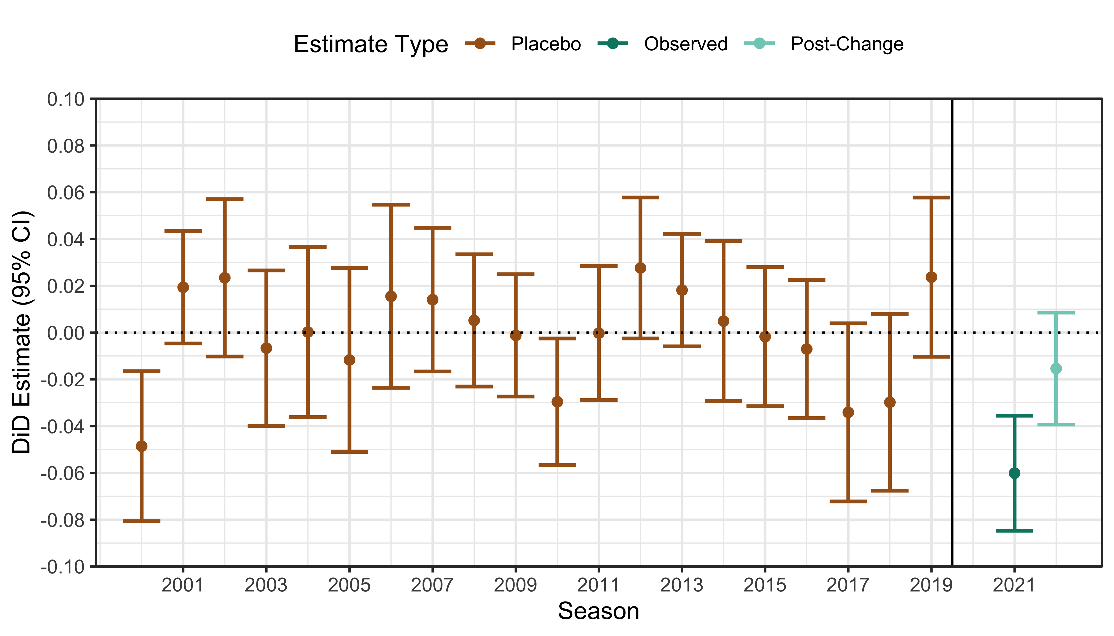
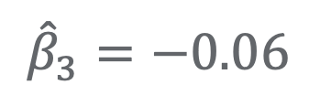
Results: Log Scale
$${\hat{β}}_{3}=−0.06$$
Data: www.retrosheets.org/gamelogs

Slide 36
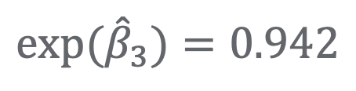
Results: Log Scale
$${\hat{β}}_{3}=−0.06$$
$${exp⁡(\hat{β}}_{3})=0.942$$
Data: www.retrosheets.org/gamelogs

Slide 37
Results: Log Scale
$${\hat{β}}_{3}=−0.06$$
$${exp⁡(\hat{β}}_{3})=0.942$$
228 minutes
vs.
242 minutes
Data: www.retrosheets.org/gamelogs

Slide 38
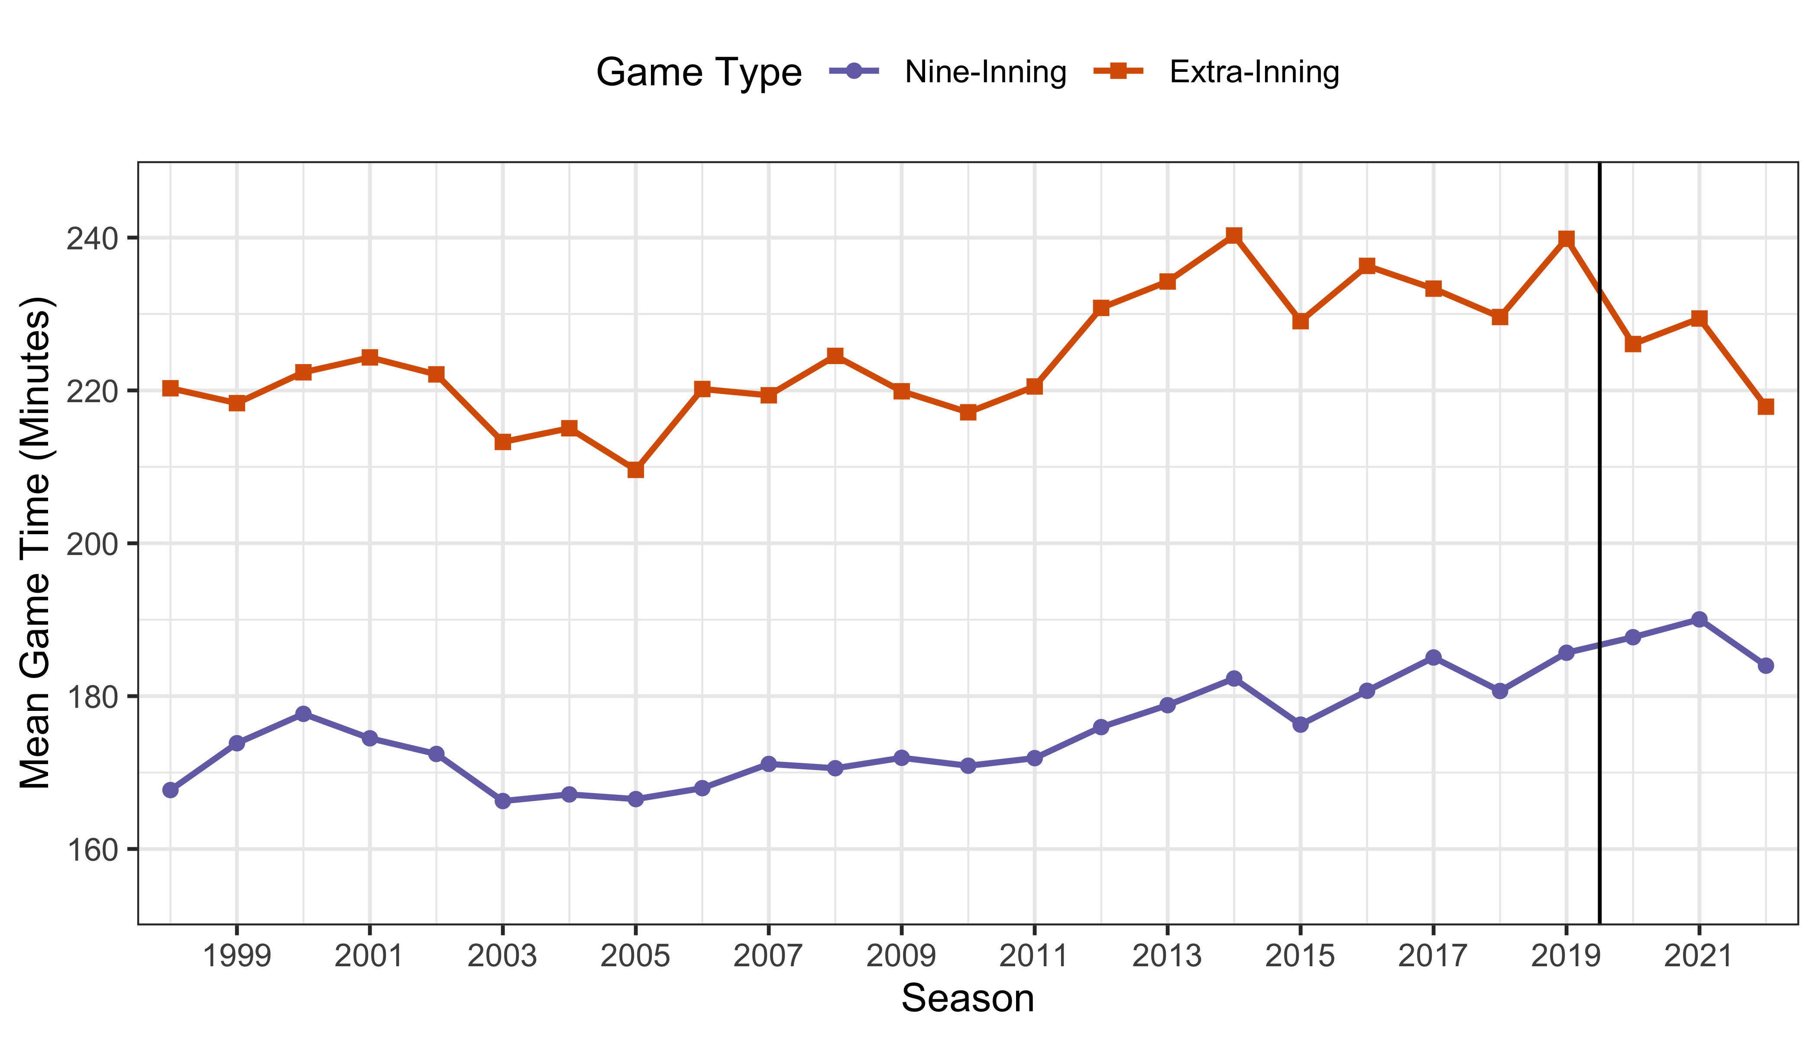
Extending to 2022
Data: www.retrosheets.org/gamelogs

Slide 39
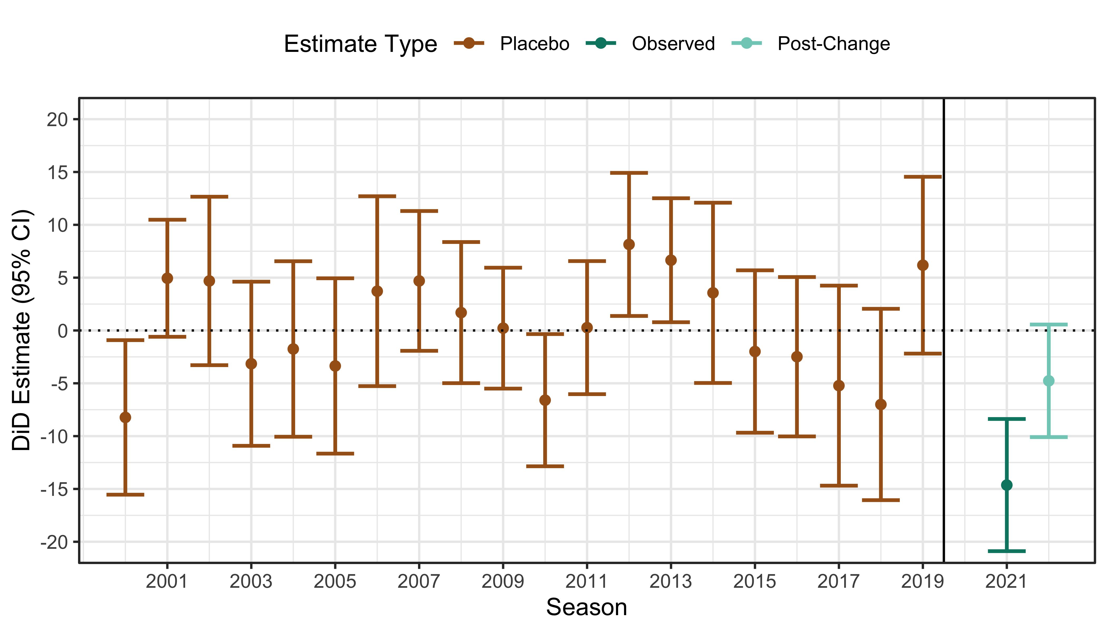
Extending to 2022
Data: www.retrosheets.org/gamelogs

Slide 40
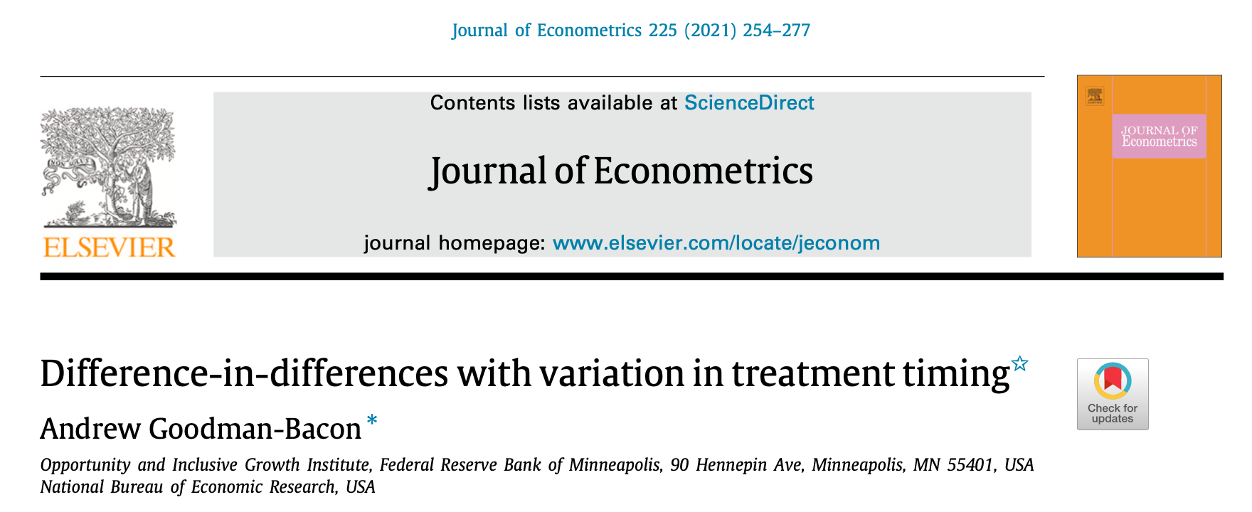
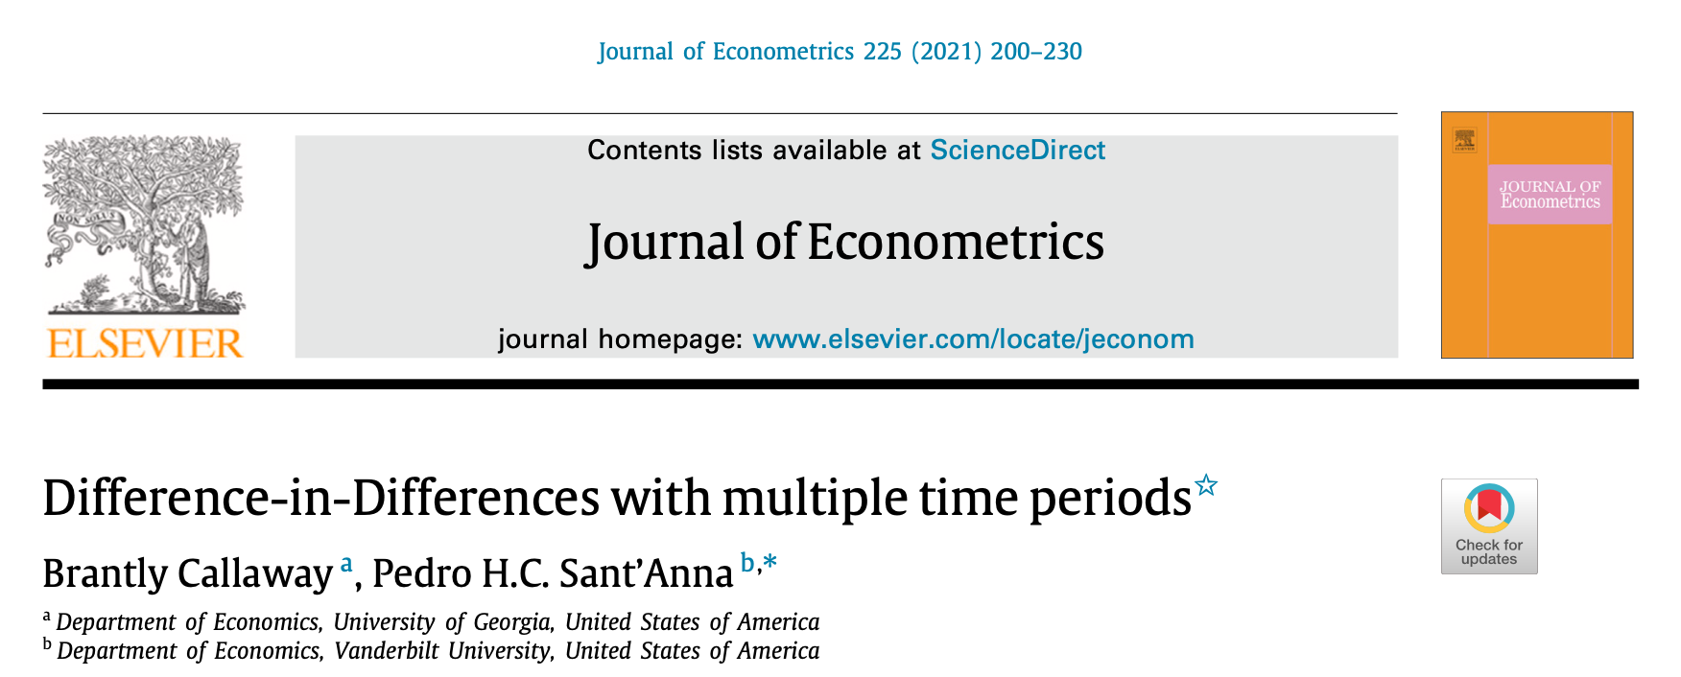
Complicating DiD
Covariate Adjustment
Multiple Control/Treated Units
Staggered Treatment Times
Other Quasi-Experimental Methods: Regression Discontinuity, Synthetic Control, …

Slide 41
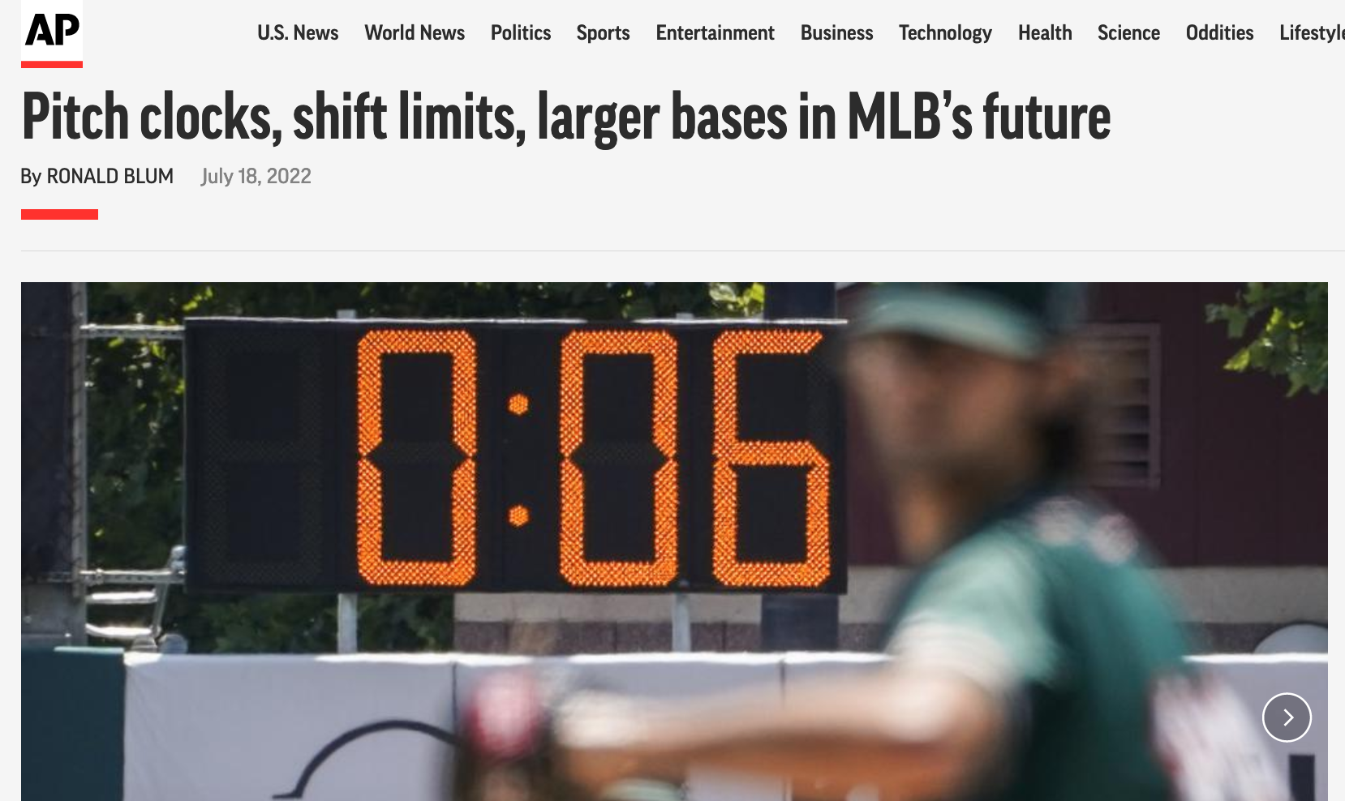
Quasi-Experiments in Baseball …
https://apnews.com/article/mlb-sports-baseball-justin-verlander-35f86e57c06774282082c8733c63c287

Slide 42
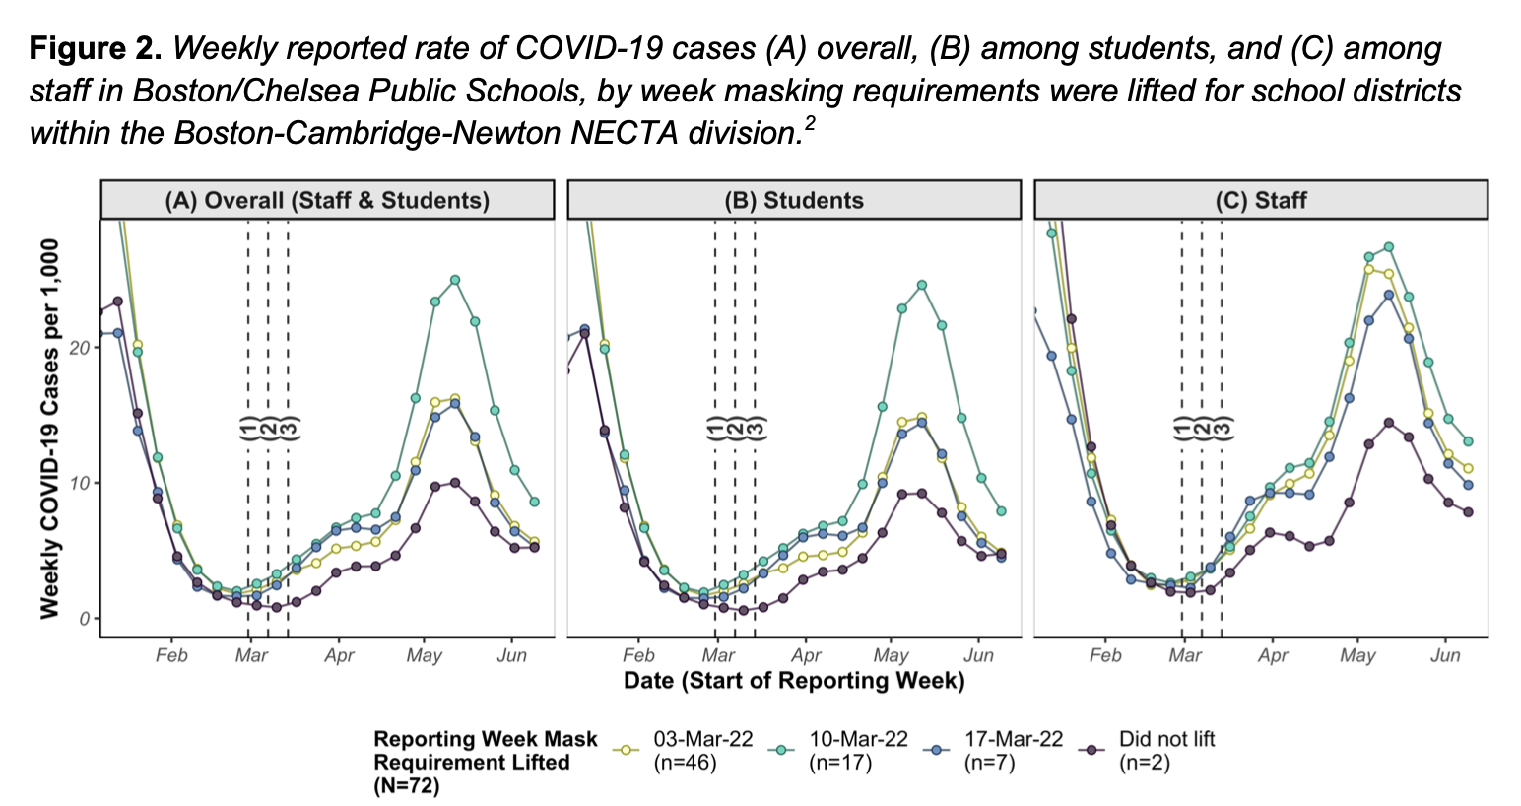
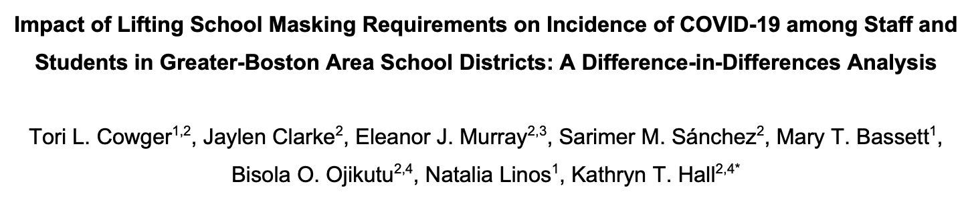
… and Beyond

Slide 43
Synthetic Control: Shifting Trends

Slide 44
Changes in Baseball Continue
https://apnews.com/article/mlb-sports-baseball-justin-verlander-35f86e57c06774282082c8733c63c287

Slide 45
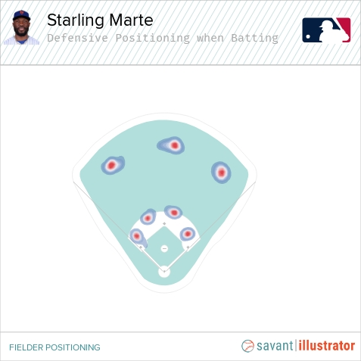
The Shift
https://baseballsavant.mlb.com/visuals/batter-positioning

Slide 46
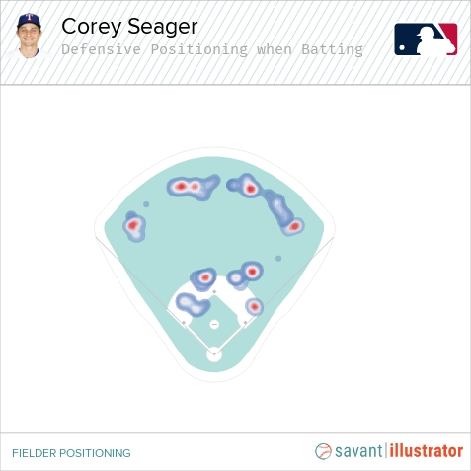
The Shift
https://baseballsavant.mlb.com/visuals/batter-positioning

Slide 47
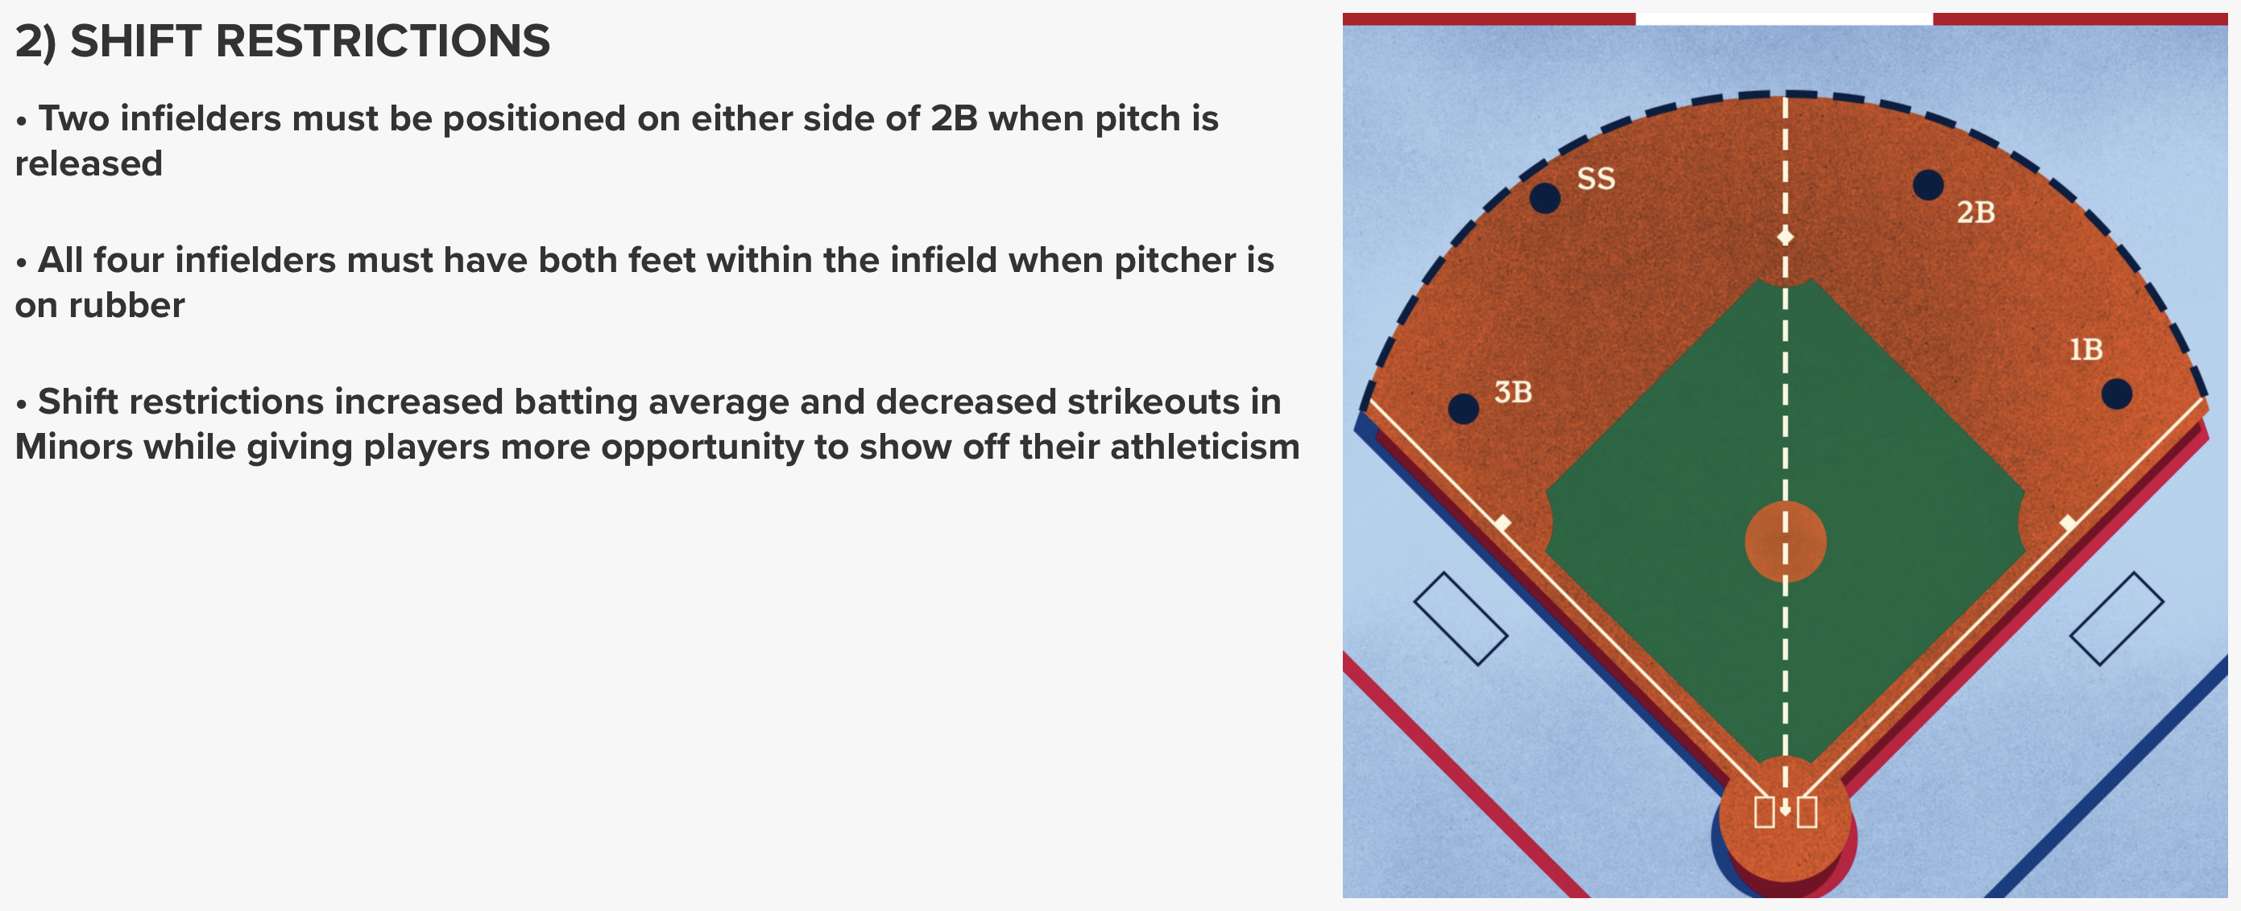
Shift Ban
https://www.mlb.com/rule-changes-2023

Slide 48
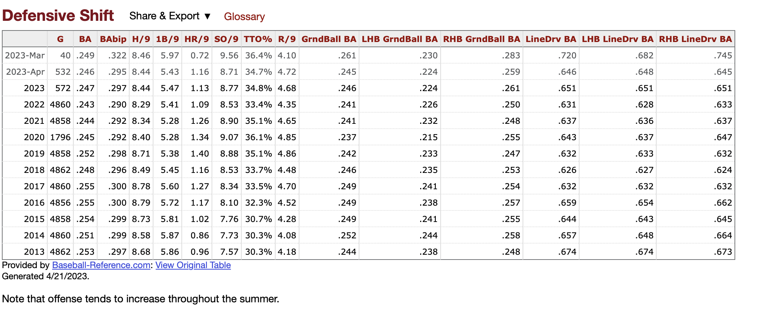
What is the Effect of the Shift?
https://www.baseball-reference.com/friv/rules-changes-stats.shtml

Slide 49
Zooming In

Slide 50
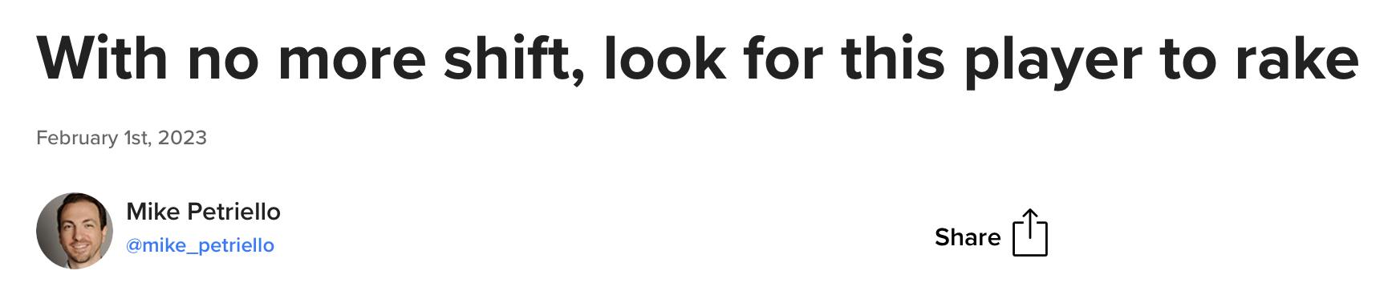
Effect on Players
https://www.mlb.com/rangers/news/how-corey-seager-can-benefit-from-new-shift-rules

Slide 51
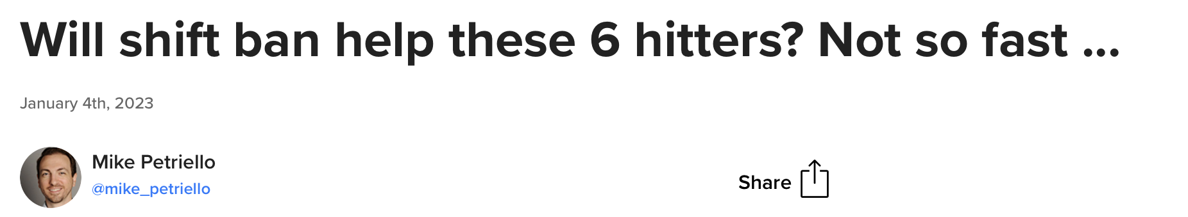
Effect on Players
https://www.mlb.com/rangers/news/how-corey-seager-can-benefit-from-new-shift-rules
https://www.mlb.com/news/shift-rule-effect-on-lefty-hitters

Slide 52
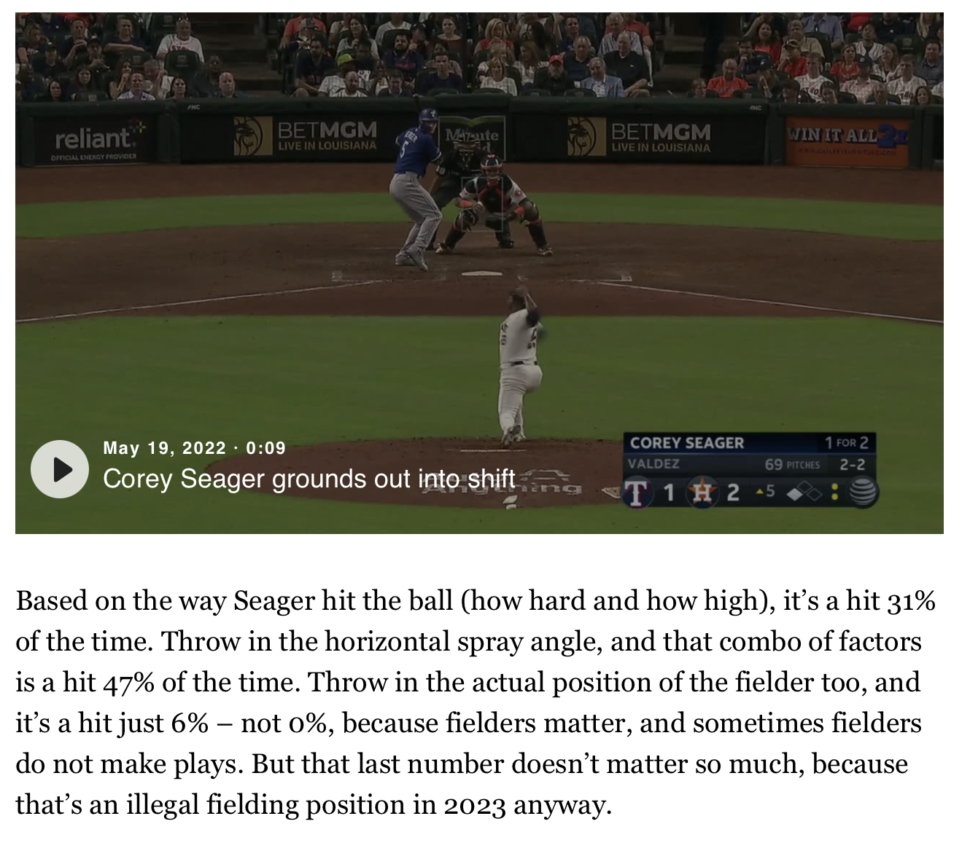
Model Directly
https://www.mlb.com/rangers/news/how-corey-seager-can-benefit-from-new-shift-rules

Slide 53
Causal Assumptions in Direct Modeling
Same Plate Appearances as Last Year
Same Overall Environment and Approach

Slide 54
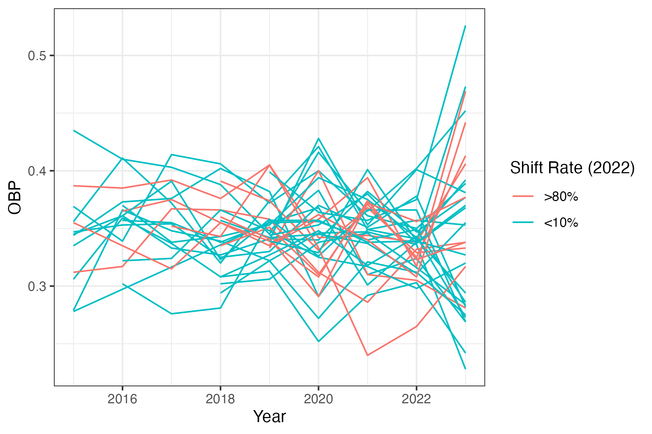
Available Player Data
Data: www.baseballsavant.com

Slide 55
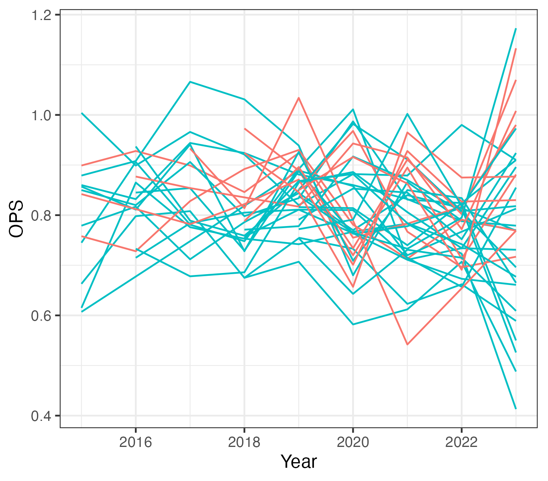
Available Player Data
Data: www.baseballsavant.com

Slide 56
Why Not DiD?
No Parallel Trends
DiD assumes unobserved confounders have constant effect over time

Slide 57
Synthetic Control: Idea and Math

Slide 58
Synthetic Control: Idea
We don’t know/have all of the covariates to use to make our treated unit exchangeable with untreated
Let the past outcome pick the comparators!

Slide 59
Synthetic Control: Idea
Find the set of weights for the untreated units so the weighted average of their outcomes pre-treatment (and any known covariates) is close to the treated unit(s).
Use those weights to construct the counterfactual.

Slide 60
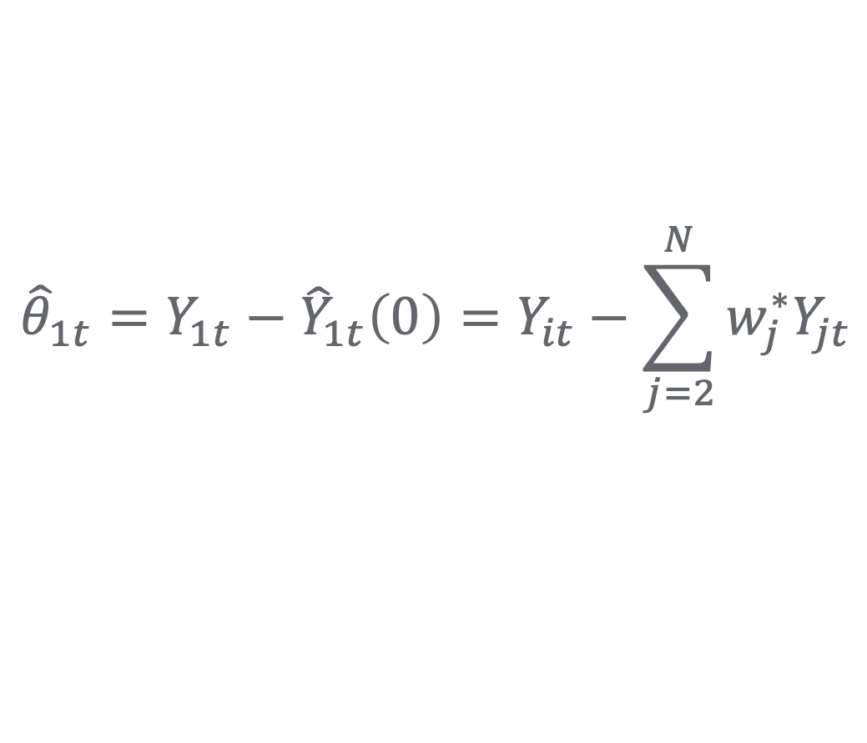
Synthetic Control: Notation
$${\hat{θ}}_{1t}=Y_{1t}−{\hat{Y}}_{1t}\left(0\right)=Y_{it}−\sum_{j=2}^{N}{w_{j}^{∗}Y_{jt}}$$

Slide 61
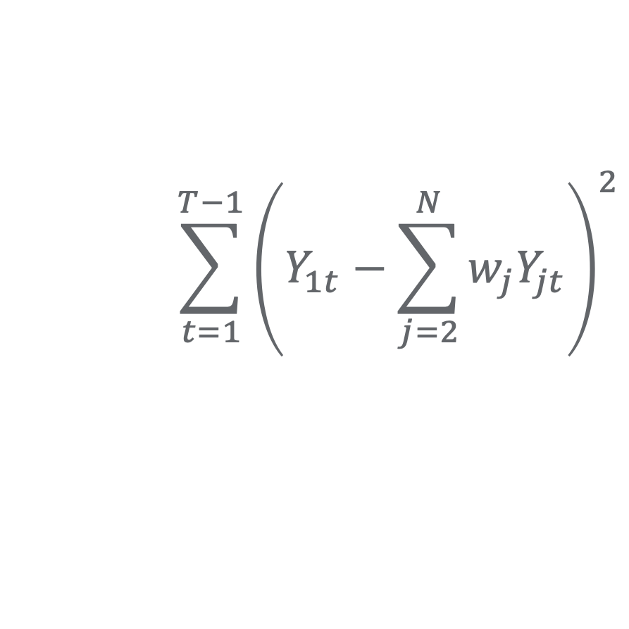

Synthetic Control: Notation
$${\hat{θ}}_{1t}=Y_{1t}−{\hat{Y}}_{1t}\left(0\right)=Y_{it}−\sum_{j=2}^{N}{w_{j}^{∗}Y_{jt}}$$
where the $w_{j}^{∗}$ minimize:
$$\sum_{t=1}^{T−1}{{\left(Y_{1t}−\sum_{j=2}^{N}{w_{j}Y_{jt}}\right)}^{2}}$$

Slide 62
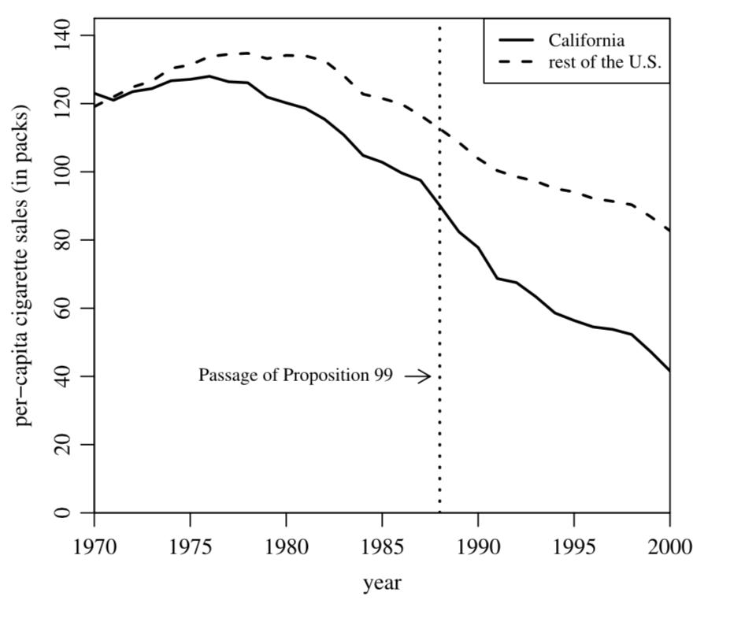
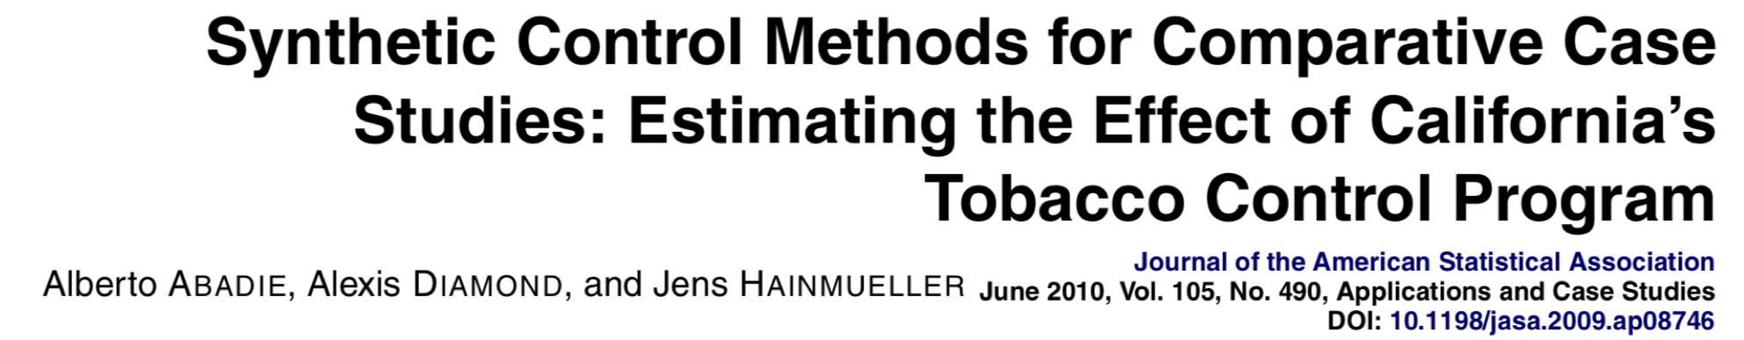
Example: California Tobacco Control

Slide 63
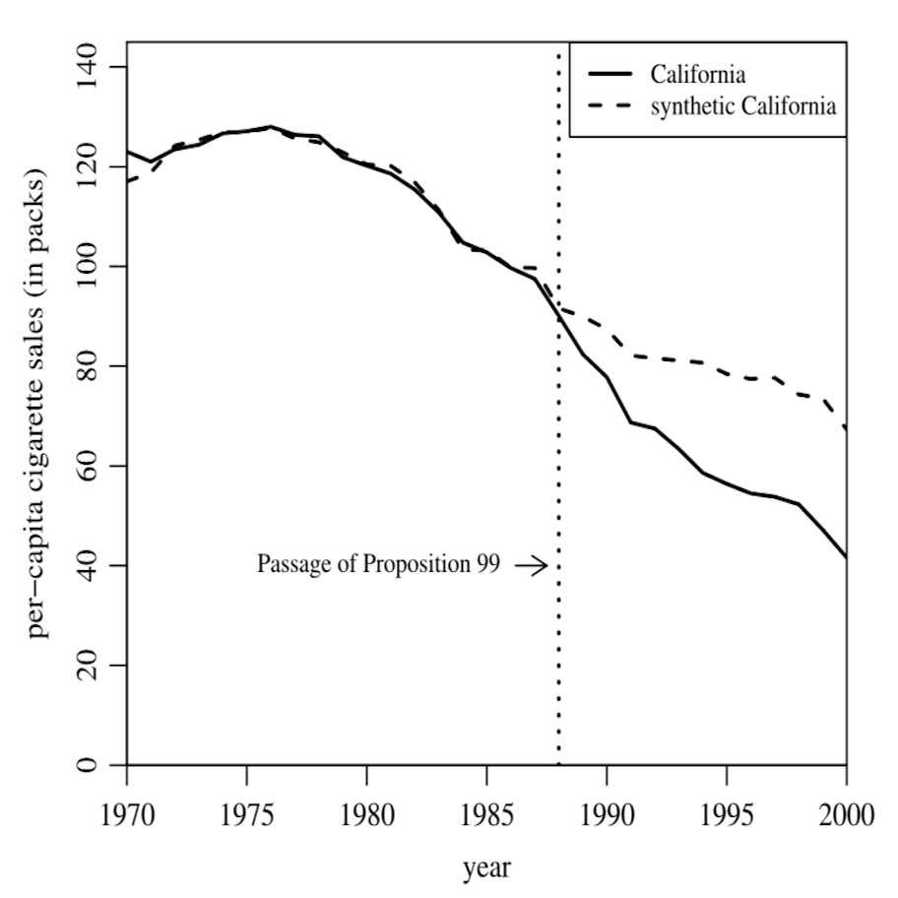
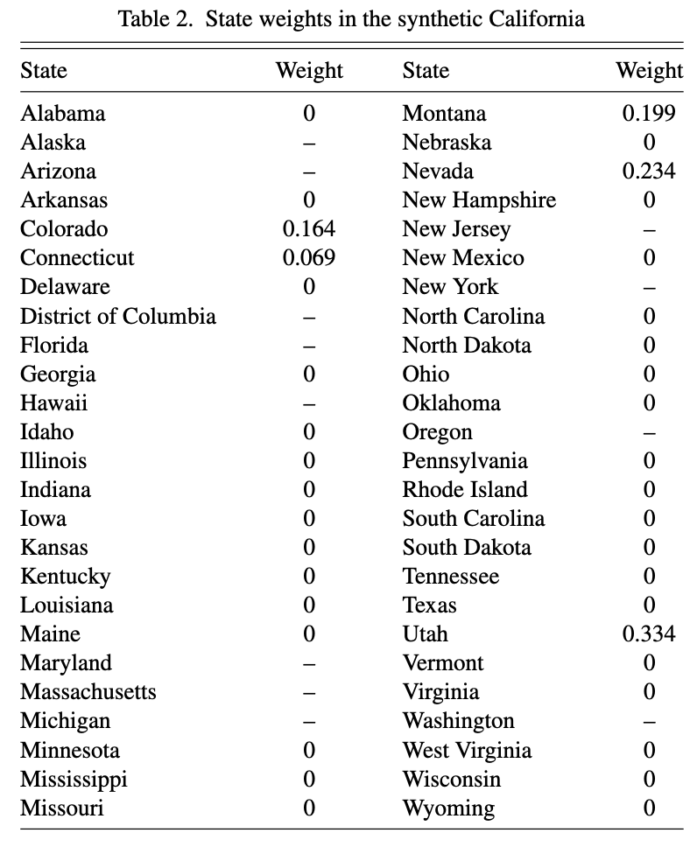
Example: California Tobacco Control

Slide 64
Challenges

Slide 65
Consistency and Generalizability
What is an “untreated” unit?

Slide 66
Consistency and Generalizability
What is an “untreated” unit?
What changes do we want to capture?

Slide 67
Consistency and Generalizability
What is an “untreated” unit?
What changes do we want to capture?
Which outcome?

Slide 68
Missing Data, Unbalanced Panels, Variability
Players miss years (esp. 2020)

Slide 69
Missing Data, Unbalanced Panels, Variability
Players miss years (esp. 2020)
Different players miss different years

Slide 70
Missing Data, Unbalanced Panels, Variability
Players miss years (esp. 2020)
Different players miss different years
Different numbers of plate appearances each year

Slide 71
Assumptions
Need to be in “convex hull”
Weights for past apply to future
Linear interpolation

Slide 72
My Approach & Results

Slide 73
Decisions
Restrict to players > 80% shifted as “treated”
Restrict to players < 10% shifted as “untreated” controls

Slide 74
Decisions
Restrict to players > 80% shifted as “treated”
Restrict to players < 10% shifted as “untreated” controls
Restrict to players with >250 PAs per year (less in 2020 and 2023 so far)
Restrict to years 2019–2022 for history

Slide 75
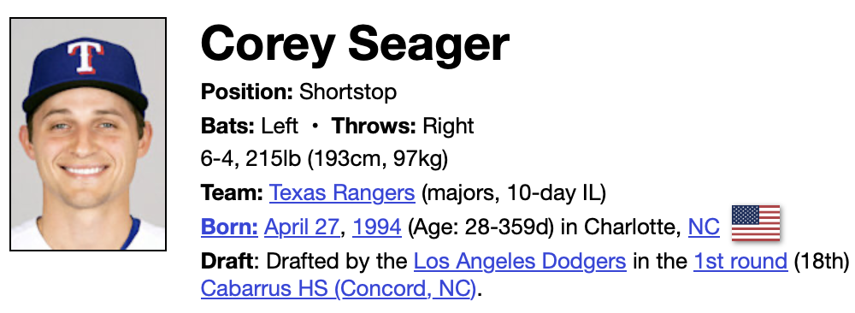
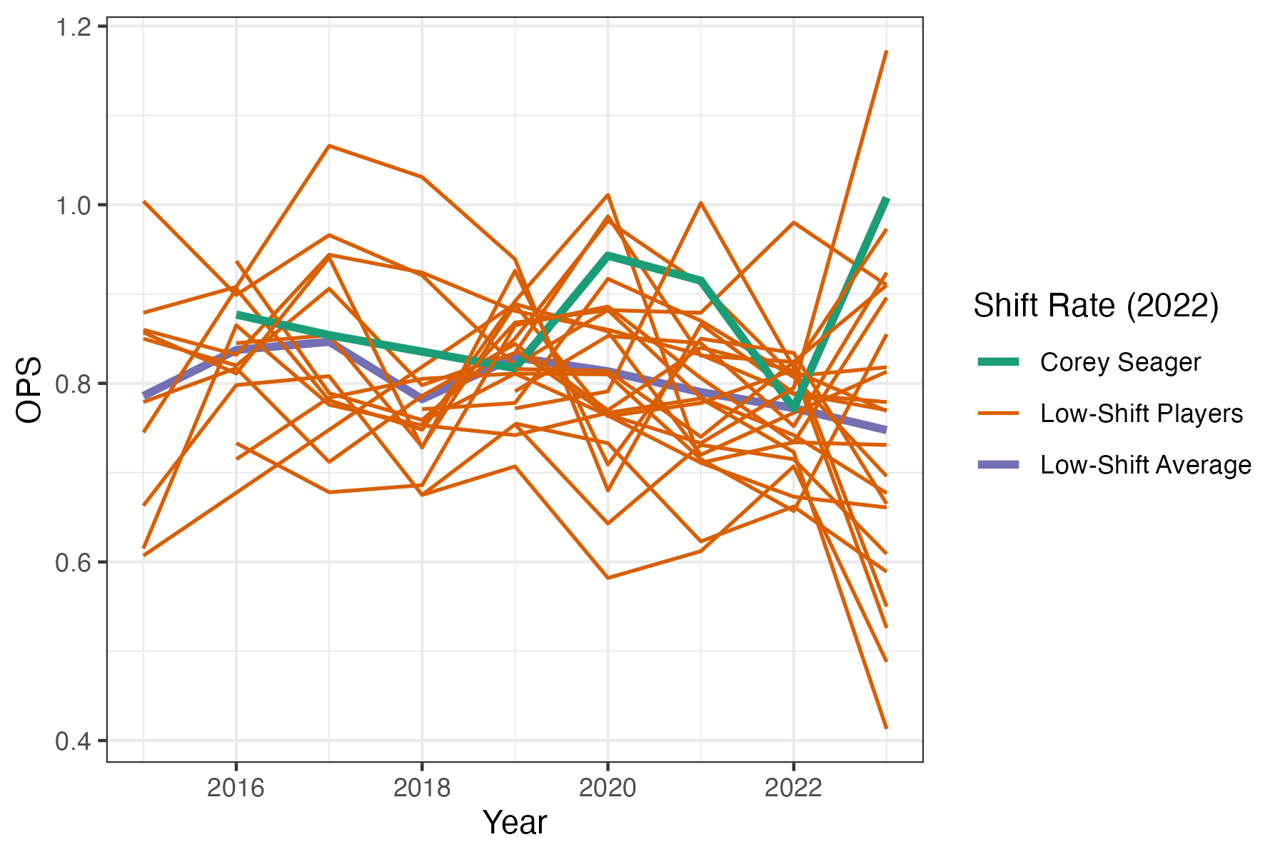
https://www.baseball-reference.com/players/s/seageco01.shtml

Slide 76
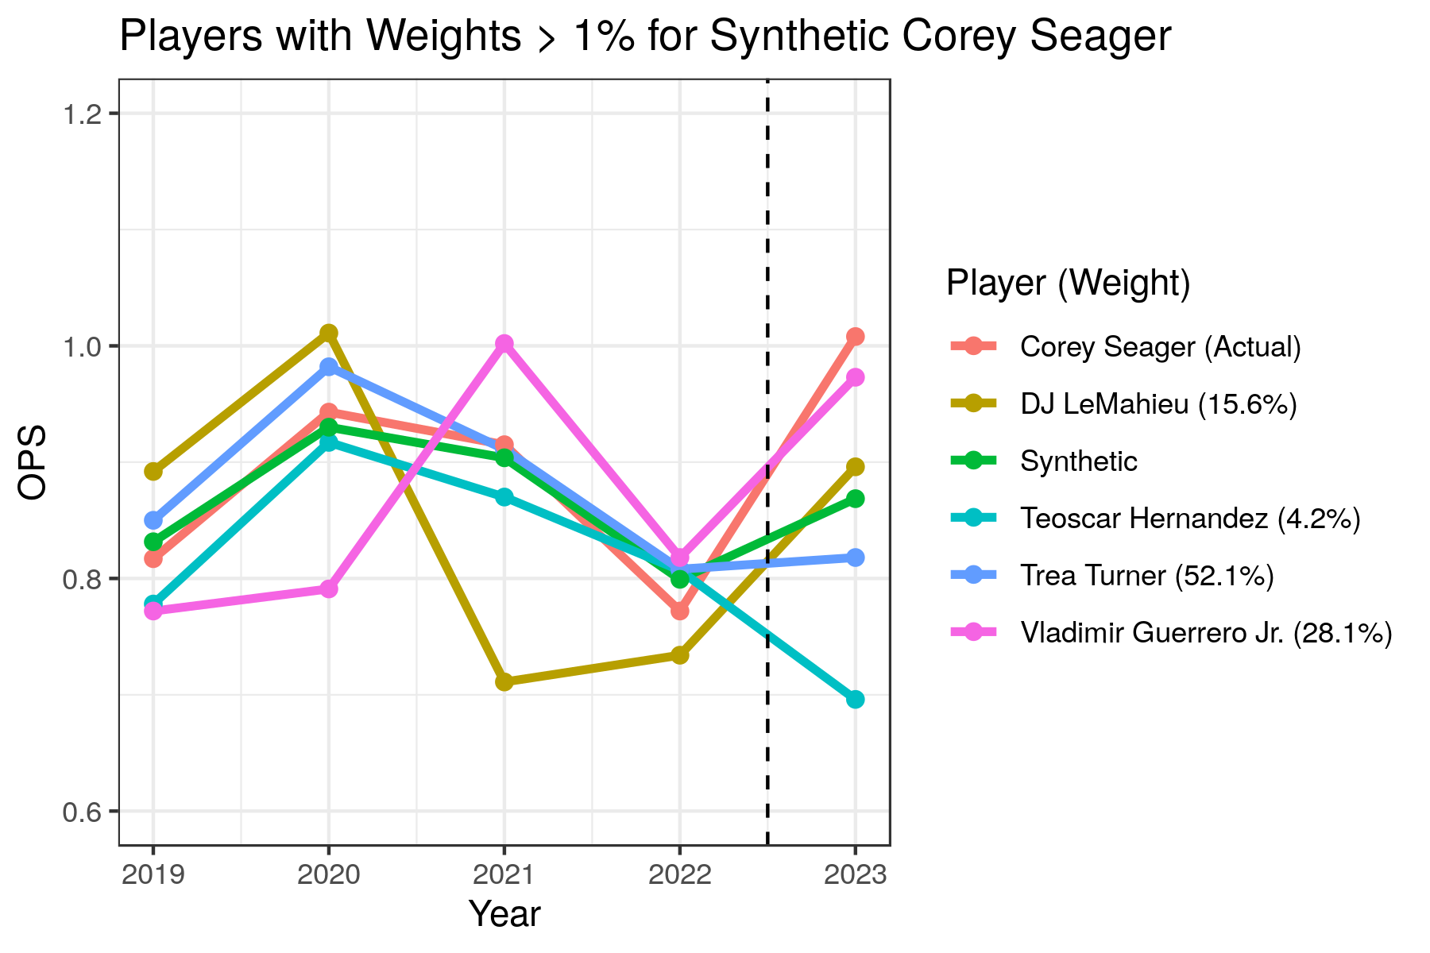
https://www.baseball-reference.com/players/s/seageco01.shtml

Slide 77
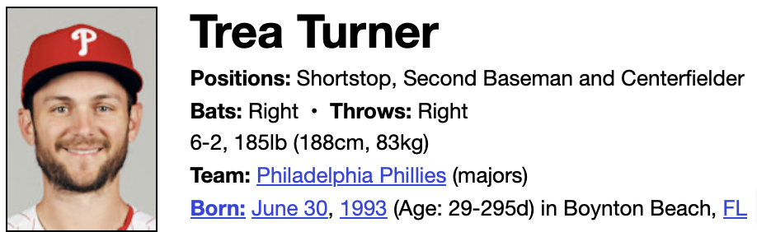
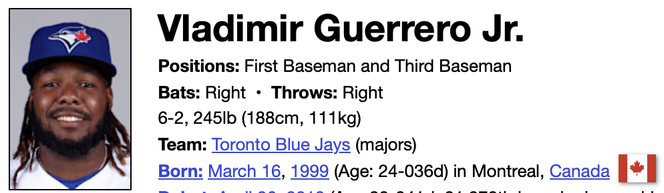
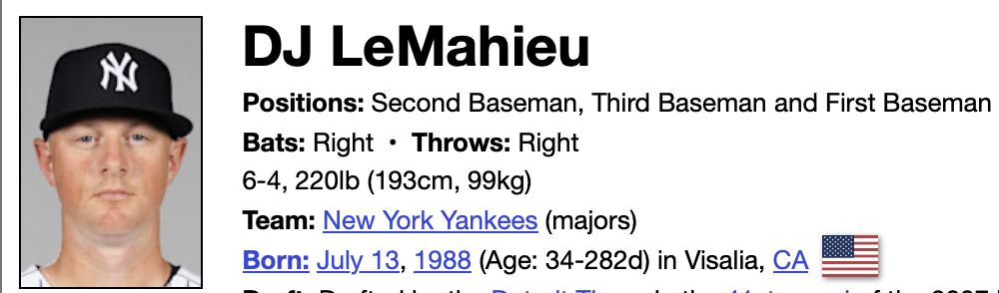
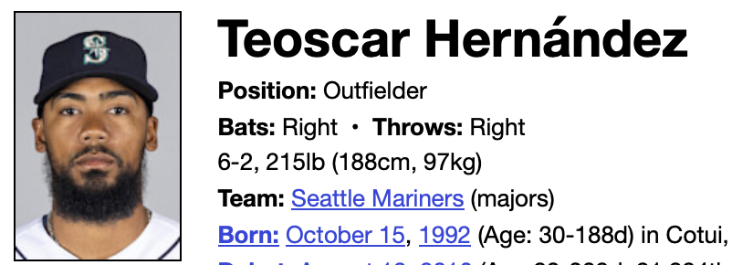
https://www.baseball-reference.com/players/...
=
0.521
+0.281
+0.156
+0.042
+…

Slide 78
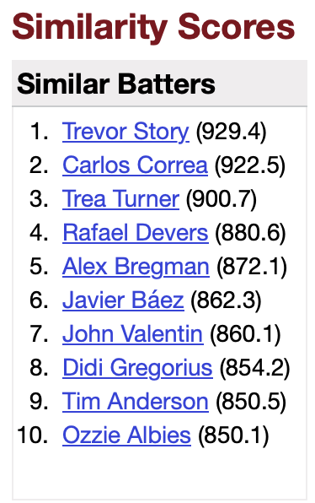
https://www.baseball-reference.com/players/...
=
0.521
+0.281
+0.156
+0.042
+…

Slide 79
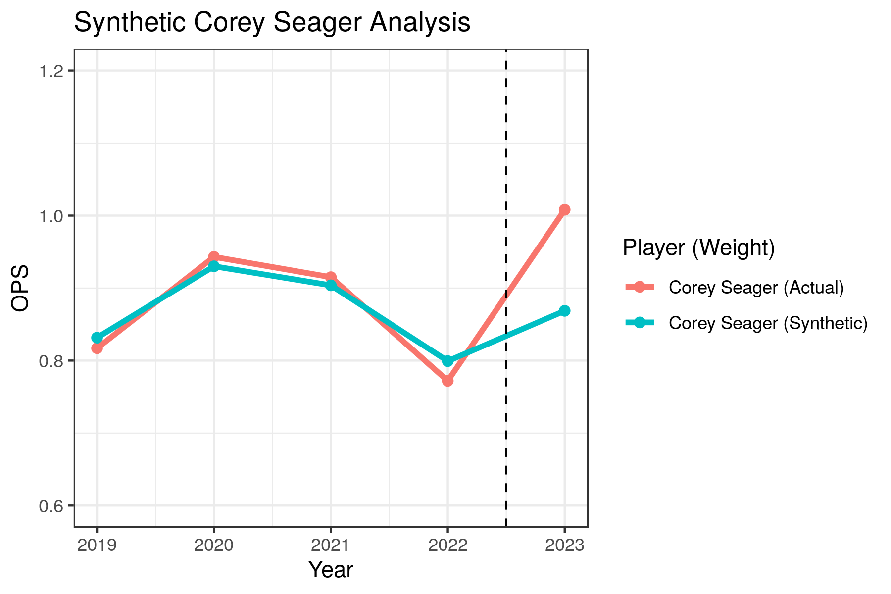
https://www.baseball-reference.com/players/s/seageco01.shtml

Slide 80
Placebo Test: In Unit
Run SC with same specification for all unaffected units using the same donor pool
Get a distribution of the estimates and compare the actual result to this placebo distribution

Slide 81
How to Improve

Slide 82
Options
Extend Donor Pool
Extend History Time Frame
Compare to Placebo Test
Adjust Covariates and What We Match

Slide 83
Conclusion

Slide 84
Quasi-Experiments: Advantages
Provide another approach to causal inference
Often have advantages in interpretability and description of assumptions
Target effect of specific change on specific unit
Another tool in the toolkit

Slide 85
Quasi-Experiments: Disadvantages
Still require untestable assumptions
Can be hard to quantify uncertainty
Target ATT, not ATE (lower generalizability)
High SUTVA/consistency dependence
Tempting to extend but not always intuitive results

Slide 86
More Details
Huntington-Klein, Nick. The Effect: An Introduction to Research Design and Causality. Boca Raton, FL: CRC Press, 2022. https://theeffectbook.net/index.html.
Cunningham, Scott. Causal Inference: The Mixtape. New Haven, CT: Yale U. Press, 2021. https://mixtape.scunning.com.

